Slide 1
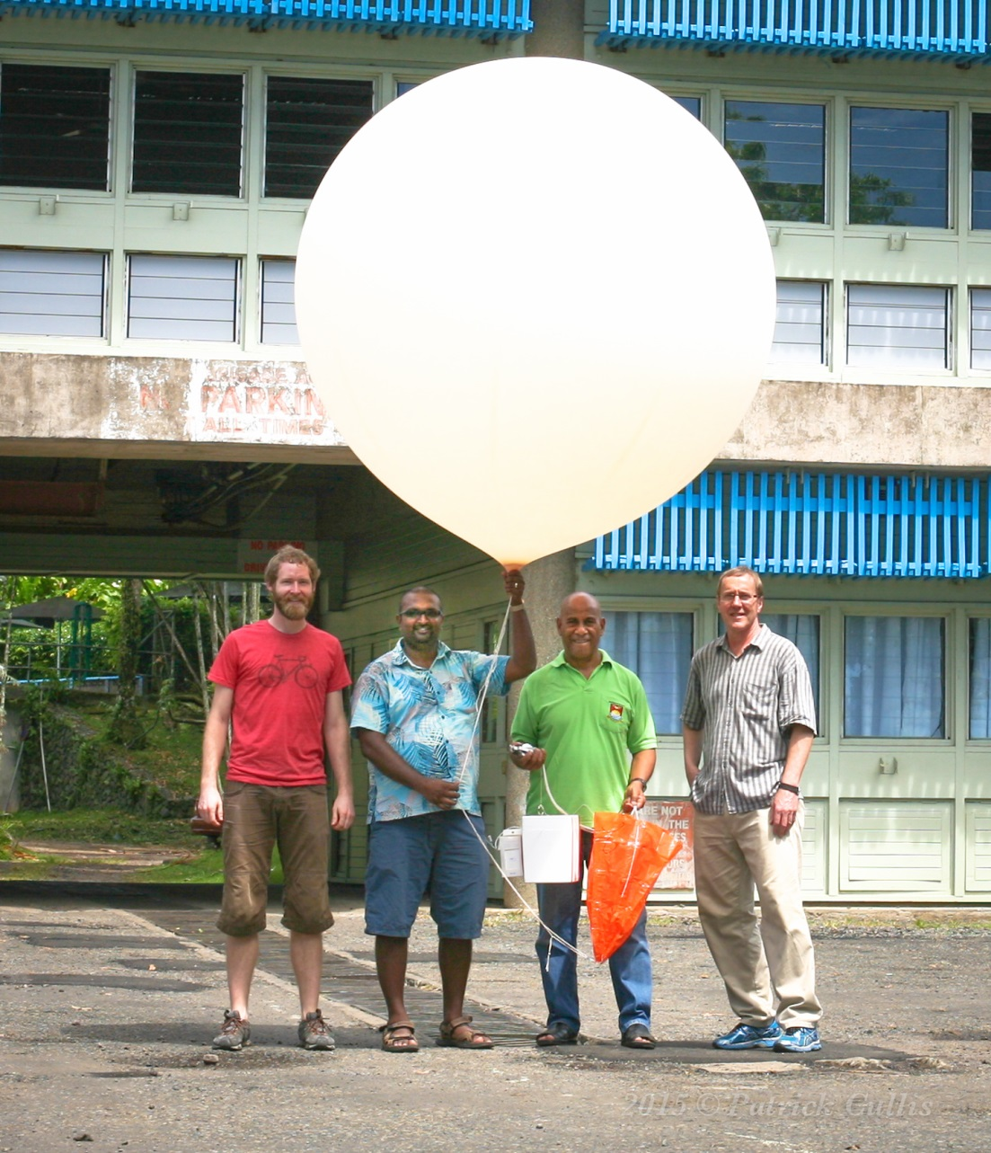
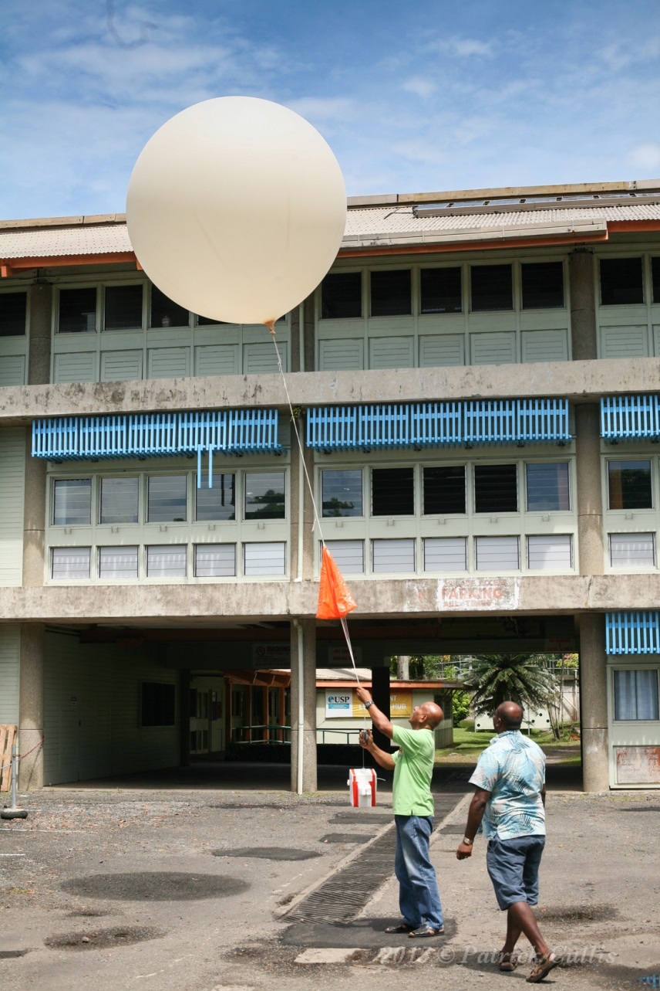
Suva, Fiji – February 2015
Patrick Cullis, Francis Mani, Matakite Maata, Bryan Johnson at the University of the South Pacific.
Matakite Maata and Francis launch FJ402

Slide 2
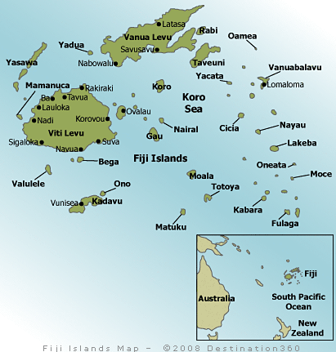

Slide 3
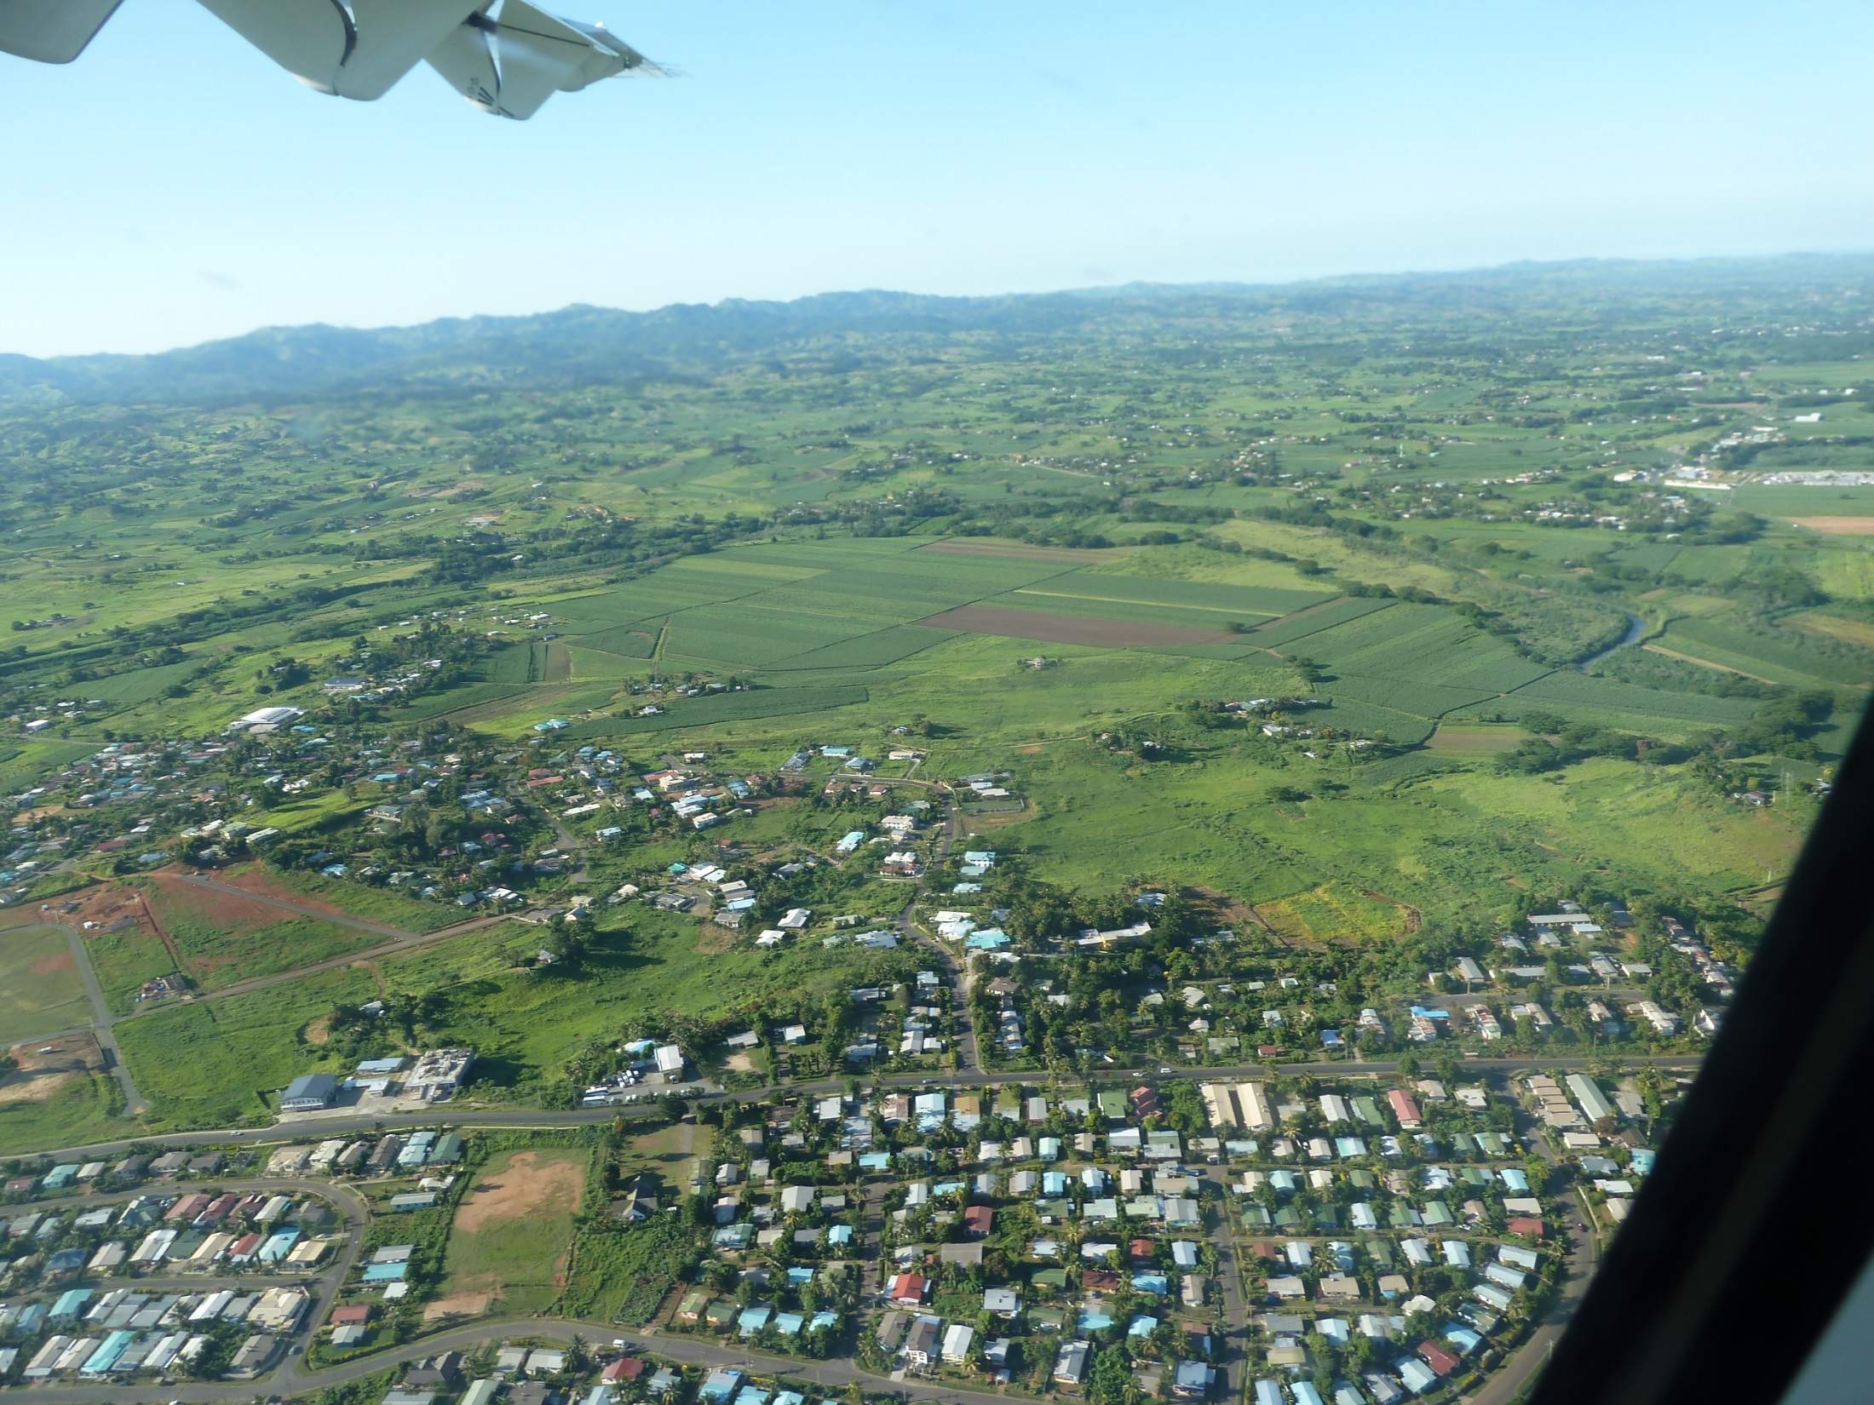
24 minute flight from Nadi to Suva

Slide 4
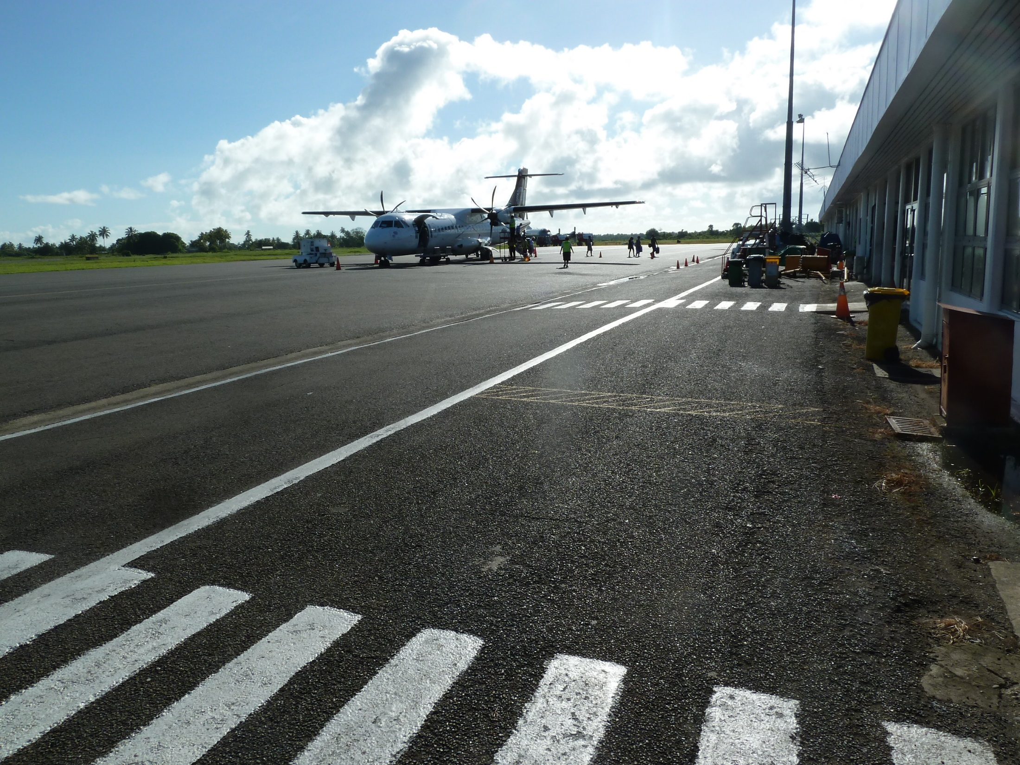
Suva Airport

Slide 5
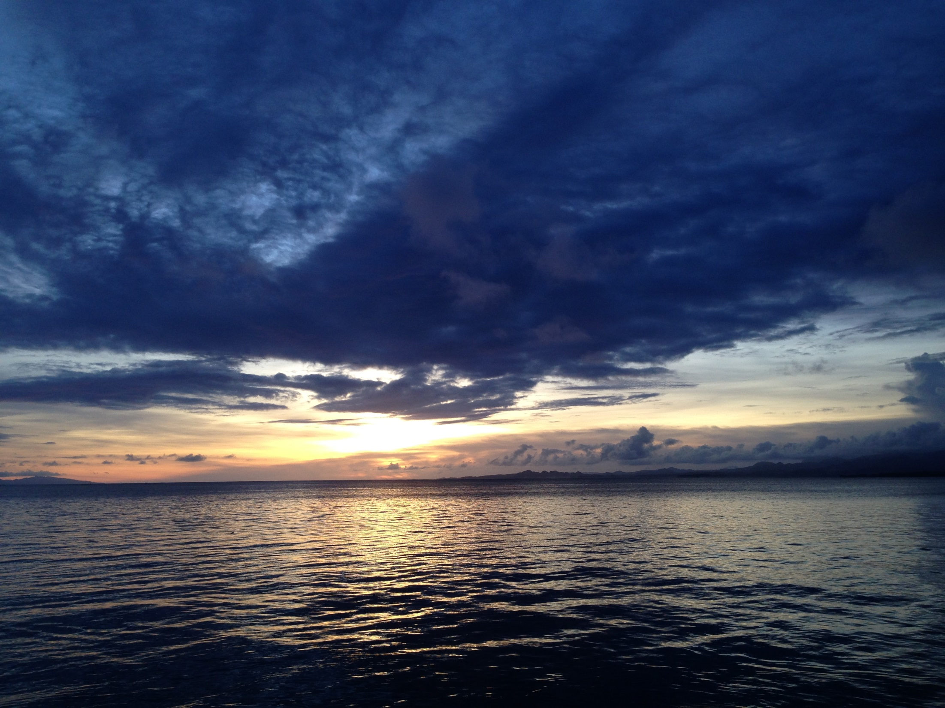

Slide 6
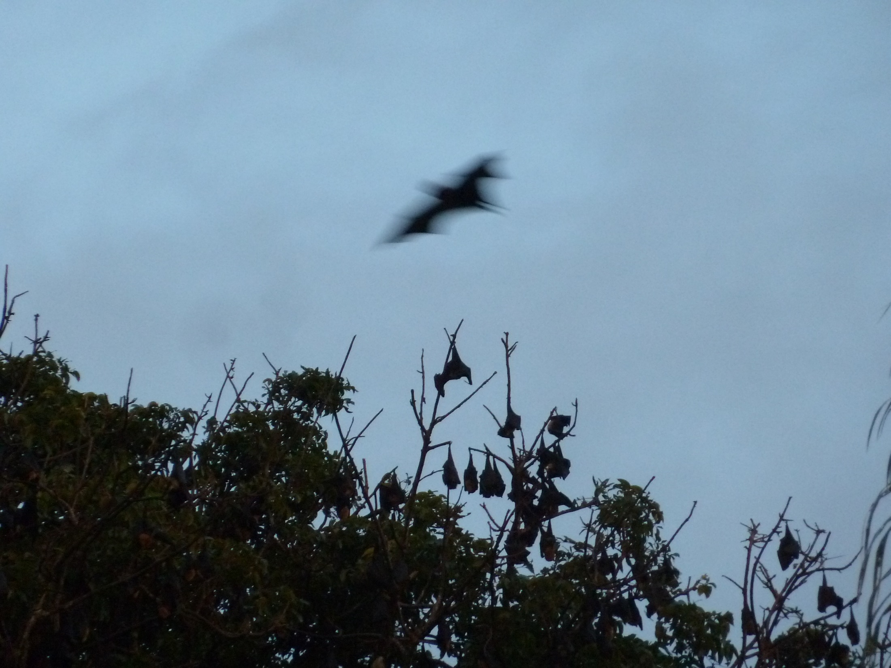
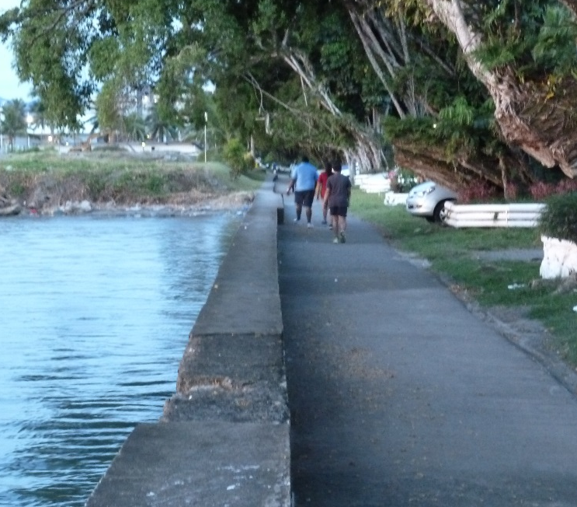
Fruit bats
They all seemed to hang around in one large tree in the park across the street from the ocean side sidewalk. About 10 minute walk from Holiday Inn.

Slide 7
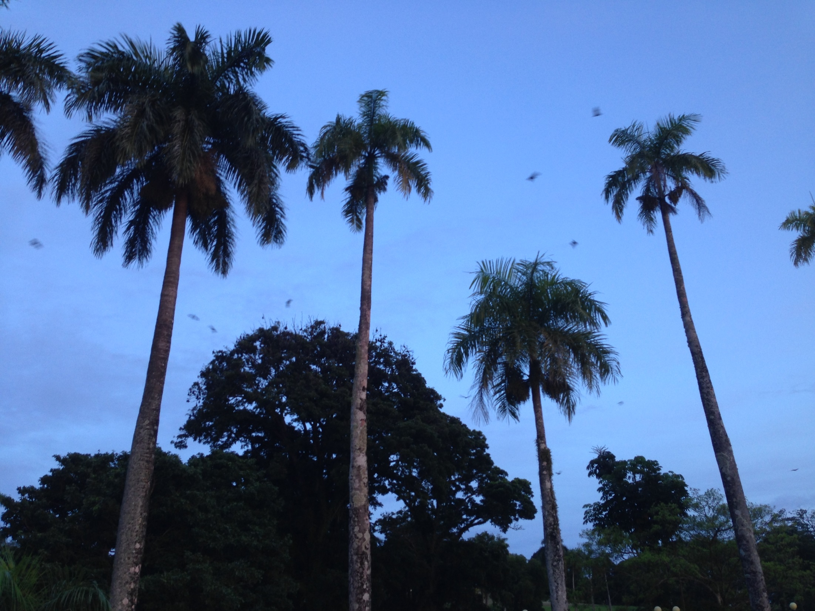

Slide 8
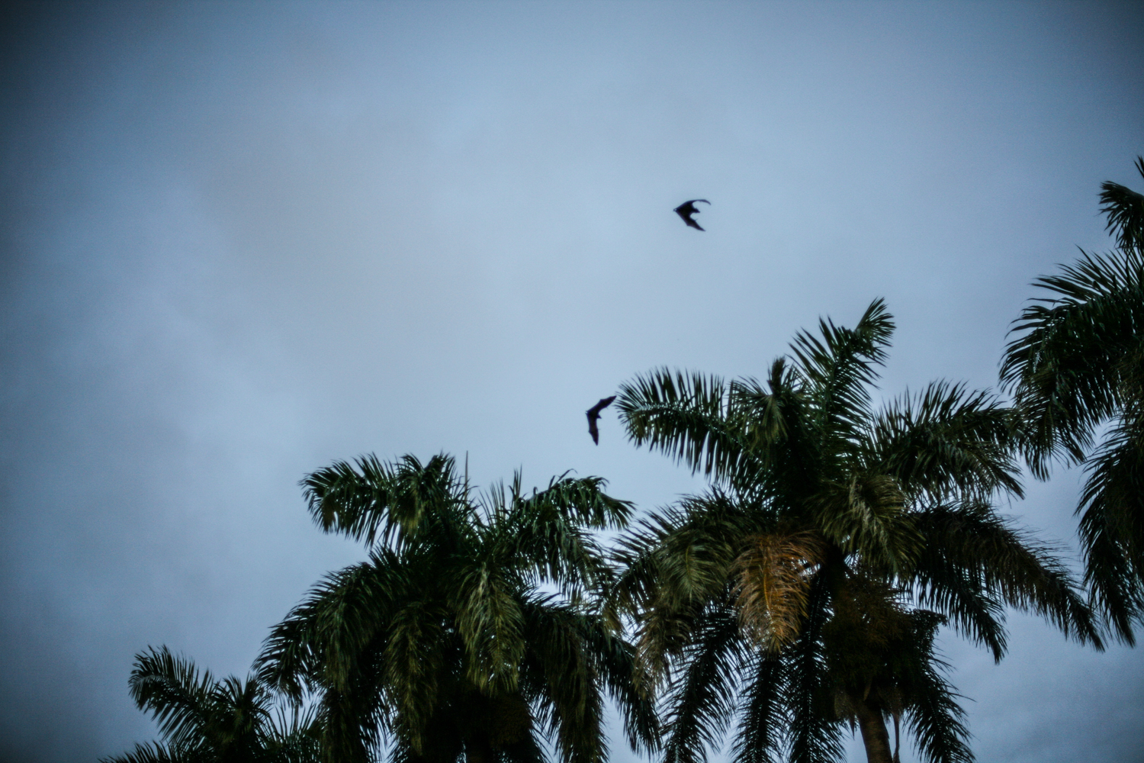

Slide 9
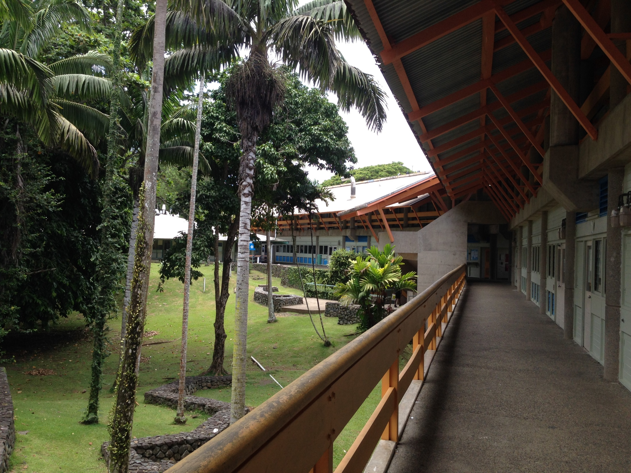
USP Campus

Slide 10
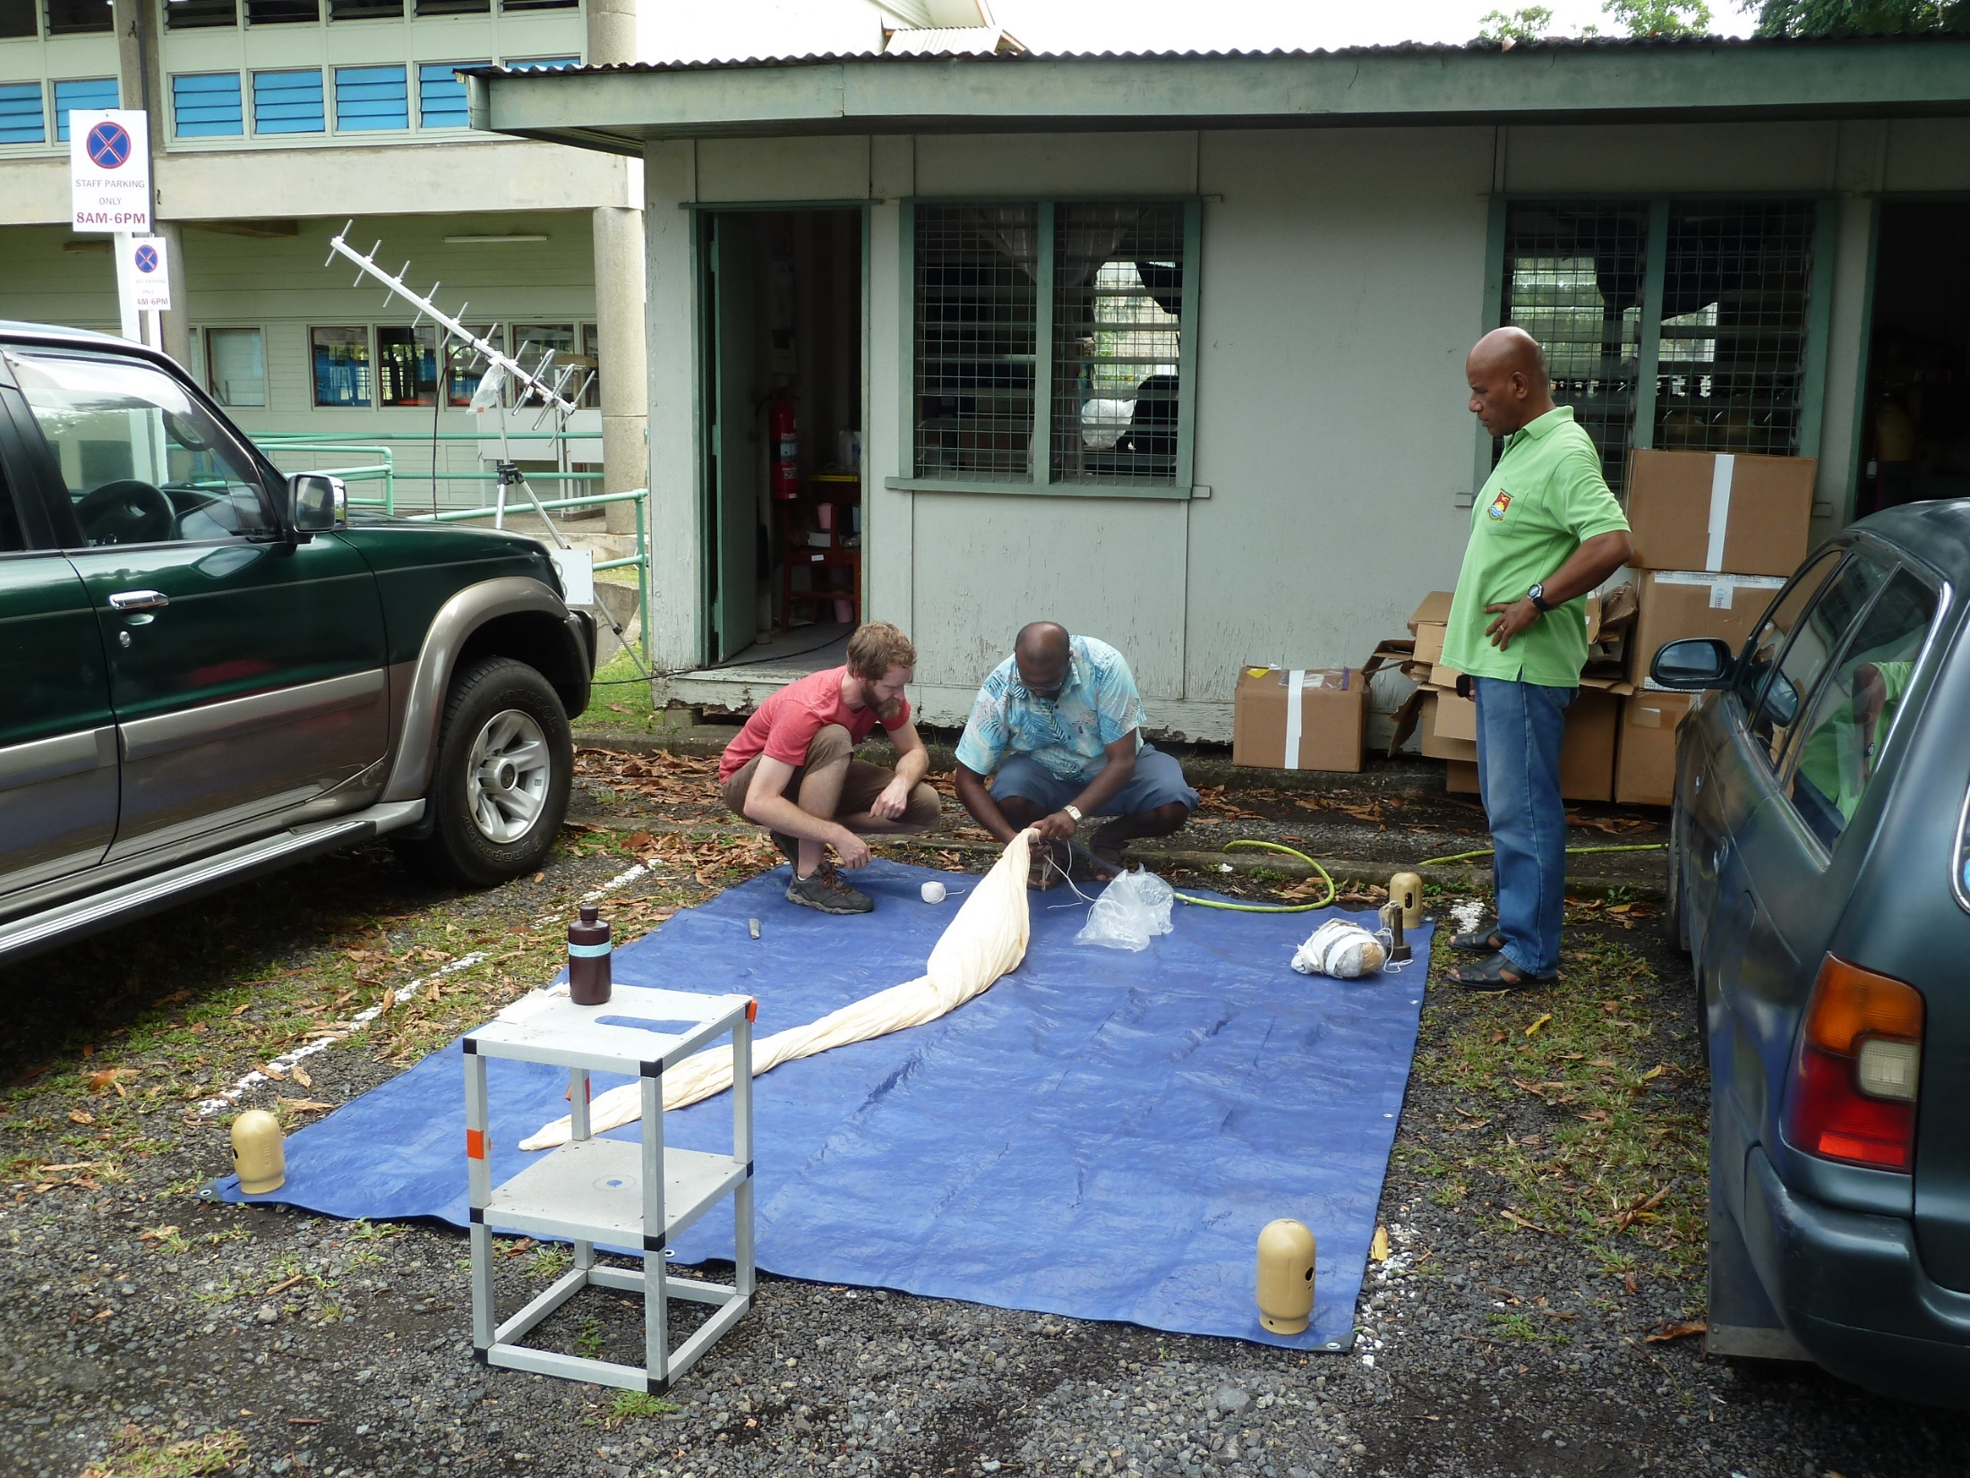
Filling the balloon.

Slide 11
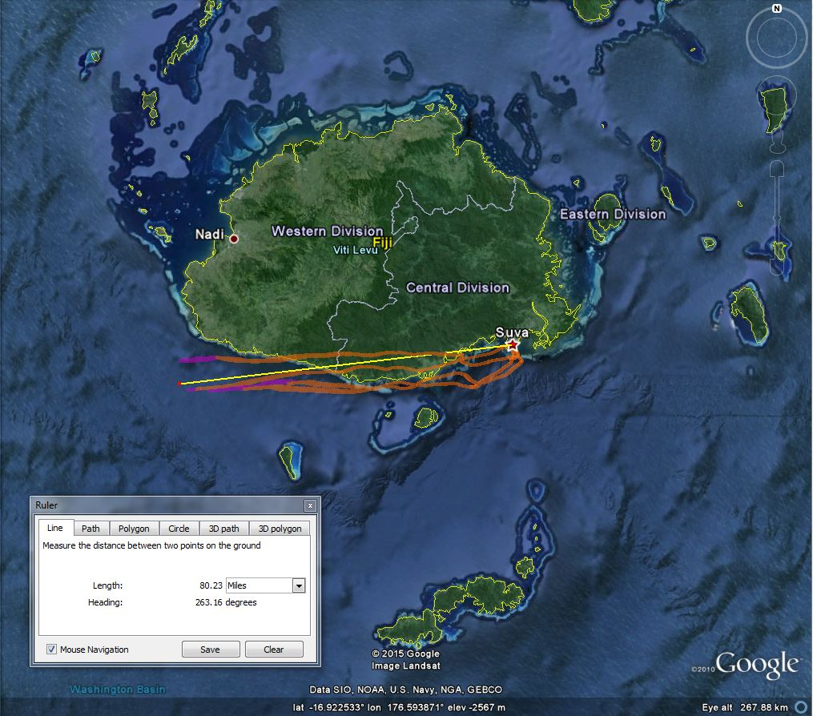

Slide 12
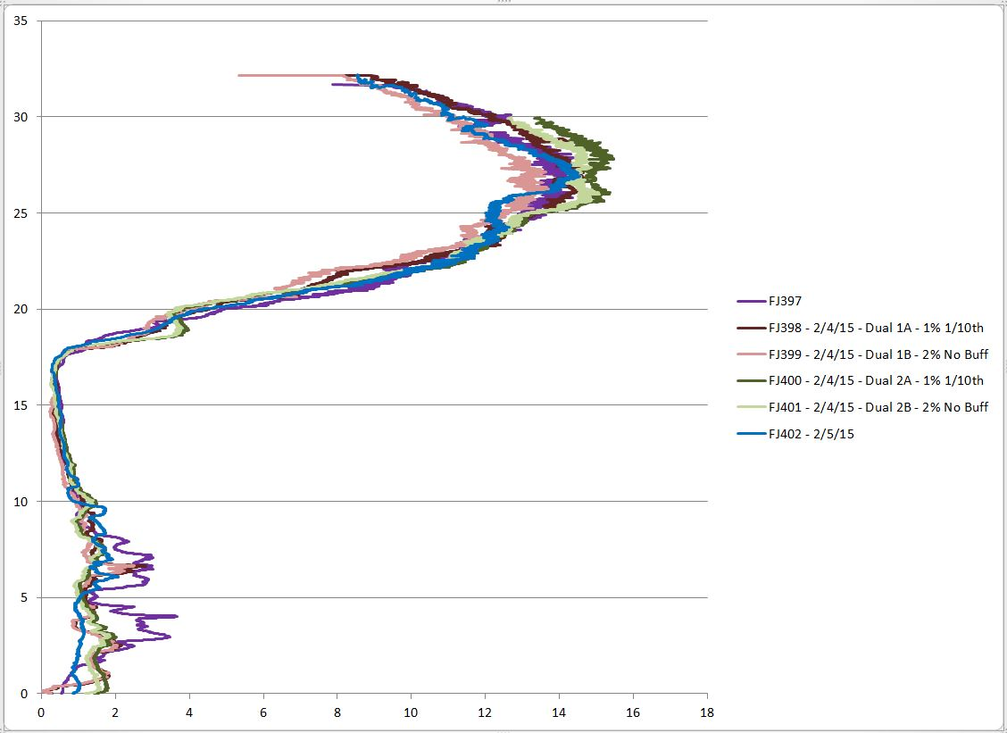
6 sondes on 4 balloons over 3 days using 2 solutions
- 2/3/15

Slide 13
Ozonesonde ECC Equation:
Р_{ozone} = 4.307x10-4 • (I – I_{BG}) • T_{pump} • T100 • PCF
Where:
Р_{ozone}= Partial pressure of ozone (millipascals).
4.307x10-4 = Constant to convert current to ozone concentration.
I = Cell current (microamps) ~ 5 μamps @ O3 peak in stratosphere.
I_{BG} = Cell background current ~ < 0.03 μamps on zero O3 filter.
T_{pump} = Temperature of sonde pump (K).
T100 = Pump flow rate: seconds per 100 cc.
PCF = Pump flow rate efficiency correction factor.

Slide 14
Ozonesonde ECC Equation:
Р_{ozone} = 4.307x10-4 • (I – I_{BG}) • T_{pump} • T100 • PCF • CF-total column • CF-Humidity Correction
Where:
Р_{ozone}= Partial pressure of ozone (millipascals).
4.307x10-4 = Constant to convert current to ozone concentration.
I = Cell current (microamps) ~ 5 μamps @ O3 peak in stratosphere.
I_{BG} = Cell background current ~ < 0.03 μamps on zero O3 filter.
T_{pump} = Temperature of sonde pump (K).
T100 = Pump flow rate: seconds per 100 cc.
PCF = Pump flow rate efficiency correction factor.
CF-total column (ratio of total column ozone from Dobson / total column sonde)
CF-Humidity Correction (0-4%) for soap bubble flow rate evaporation

Slide 15
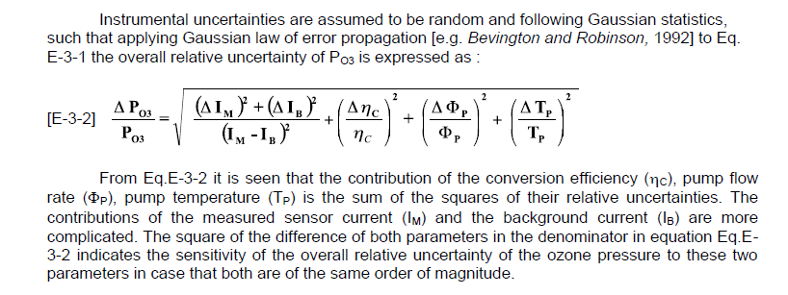
Uncertainty ozone column for NDACC and WOUDC

Slide 16
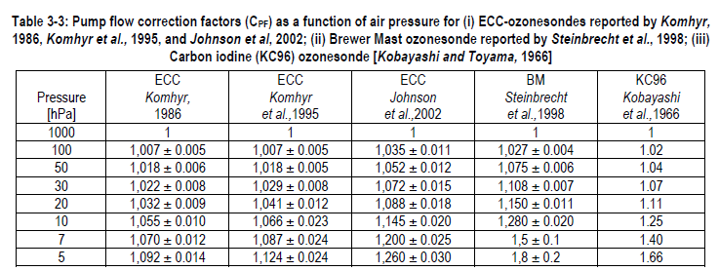

Slide 17
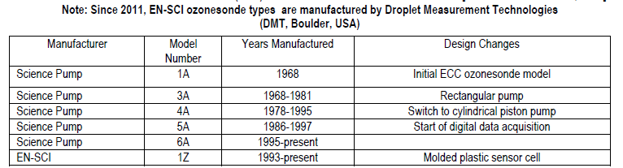

Slide 18
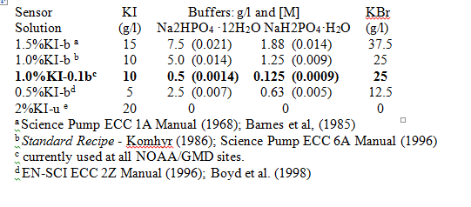
Ozonesonde sensor solutions

Slide 19
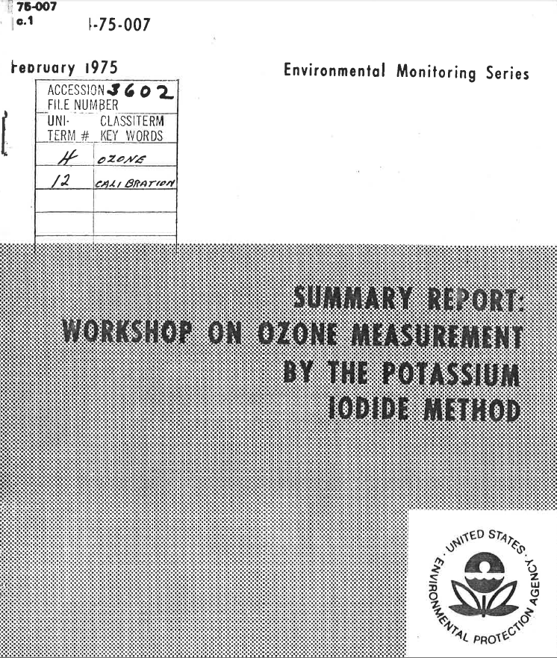
The 2% KI unbuffered solution source came from the 1960s-1970s air pollution and ozone studies. The potassium iodide method was used in colorimetric or other wet chemical methods.

Slide 20
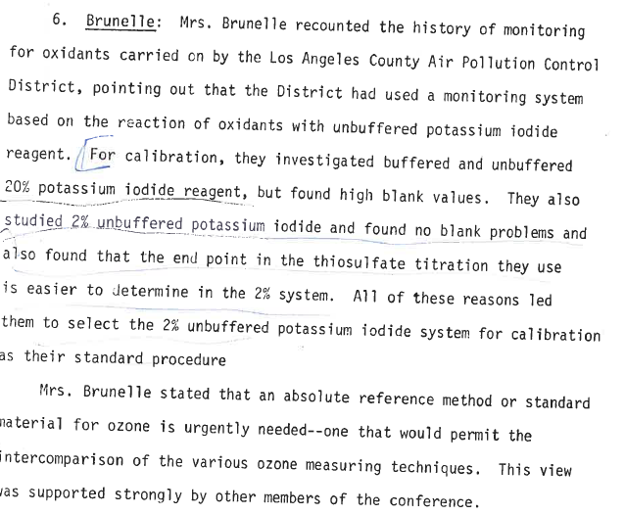

Slide 21
Birdsall, C. M., A. C. Jenkins, and E. Spadinger,
Iodometric determination of ozone,
Analytical Chemistry, 24, 662-664, 1952.
Conclusion
In the concentration investigated (1 to 35 mole %) the use of a 2% unbuffered aqueous solution of potassium iodide for the analytical determination of ozone gives precise results which are accurate to 2% when compared with a physical method.

Slide 22
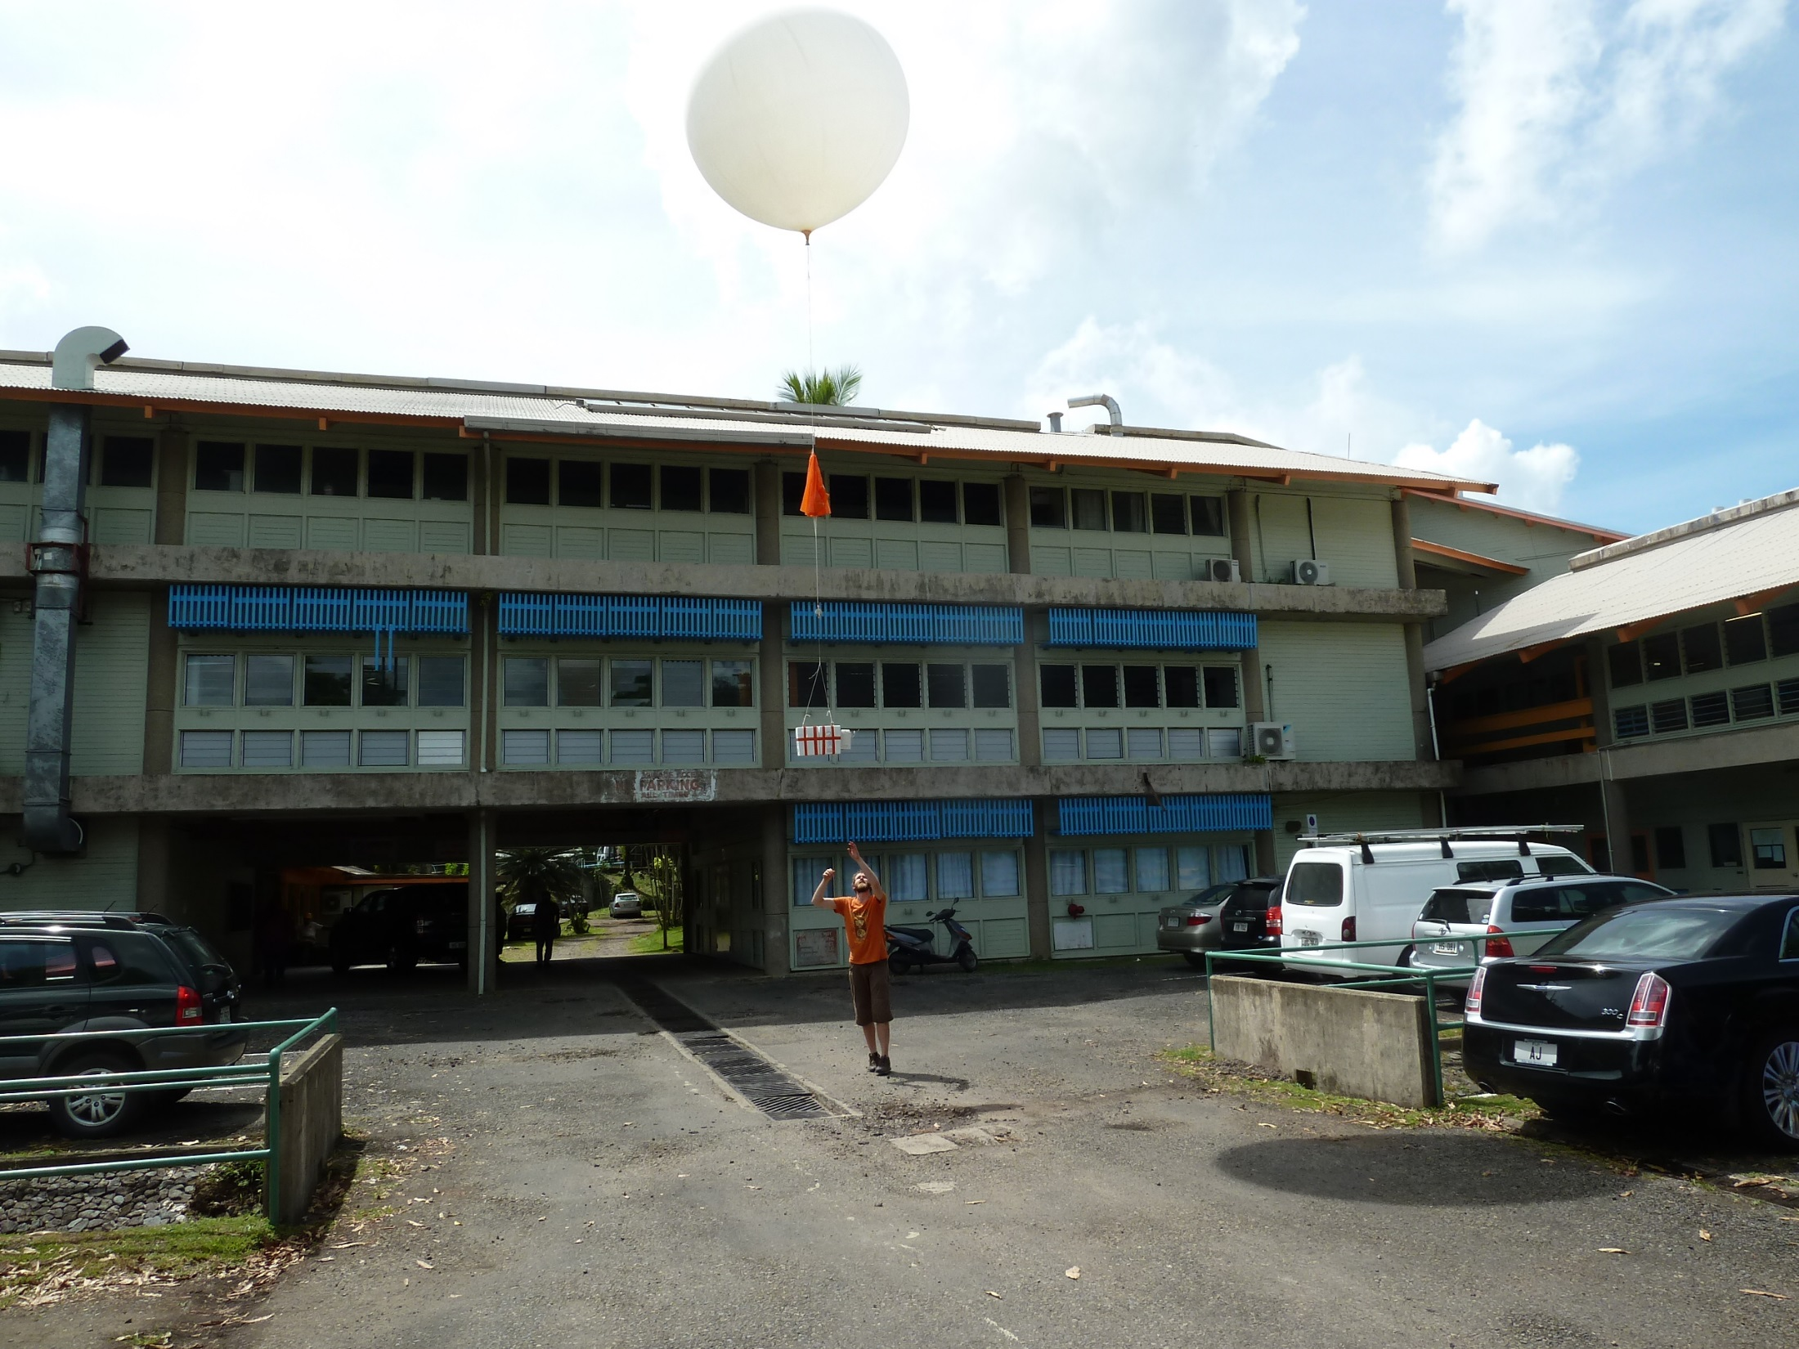
Fiji Dual Sonde Comparison:
Dual Sonde #1

Slide 23
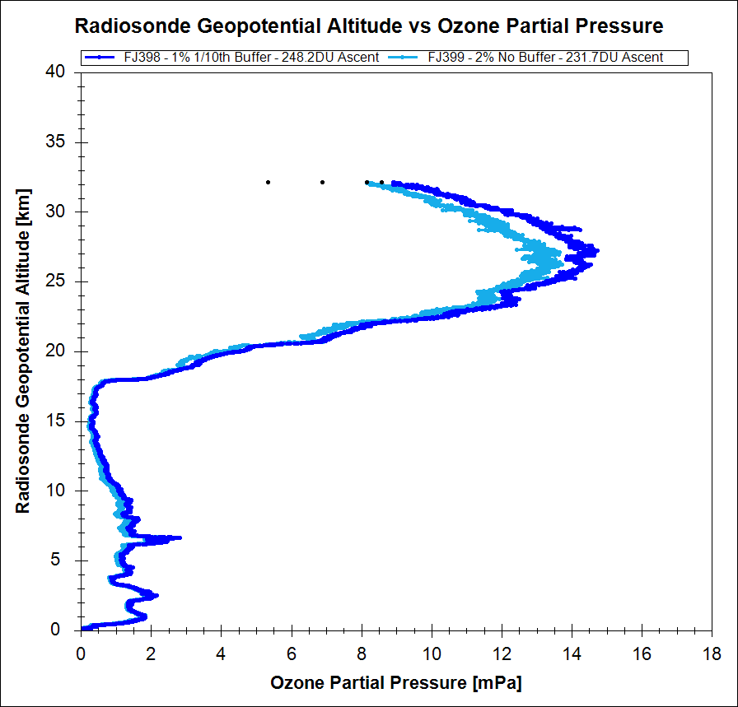
Fiji Dual Sonde 1 – 2/4/2015 @ 9:45am
Sonde A – 1% 1/10th Buffer
CMR = 269.5DU
SBUV = 248.2DU
Sonde B – 2% No Buffer
CMR = 246.4DU = -23.1DU = -8.6%
SBUV = 231.7DU = -16.5DU = -6.6%

Slide 24
Fiji Dual Sonde 1 – 2/4/2015 @ 9:45am
Sonde A – 1% 1/10th Buffer
CMR = 269.5DU
SBUV = 248.2DU
Sonde B – 2% No Buffer
CMR = 246.4DU = -23.1DU = -8.6%
SBUV = 231.7DU = -16.5DU = -6.6%
We only see 2% solutions reading low in the tropics. Difficult to apply overall correction for 2% solutions.

Slide 25
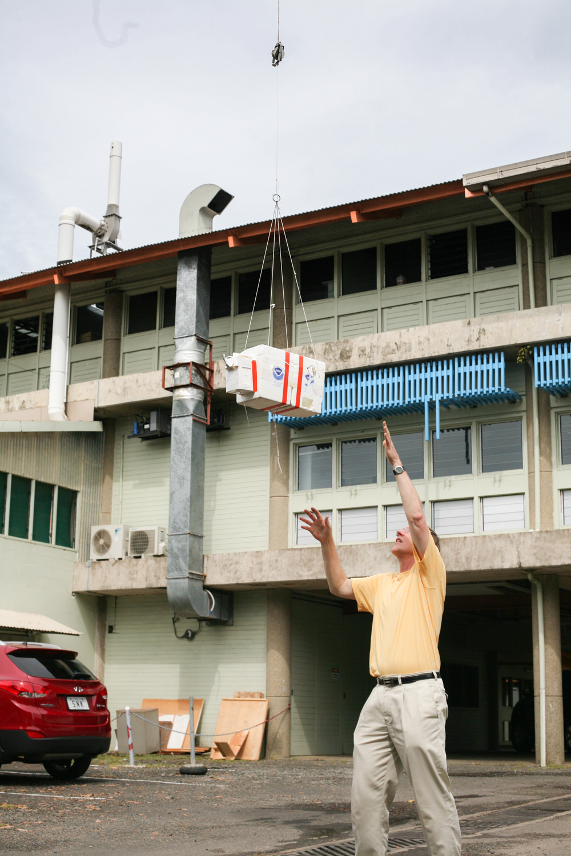
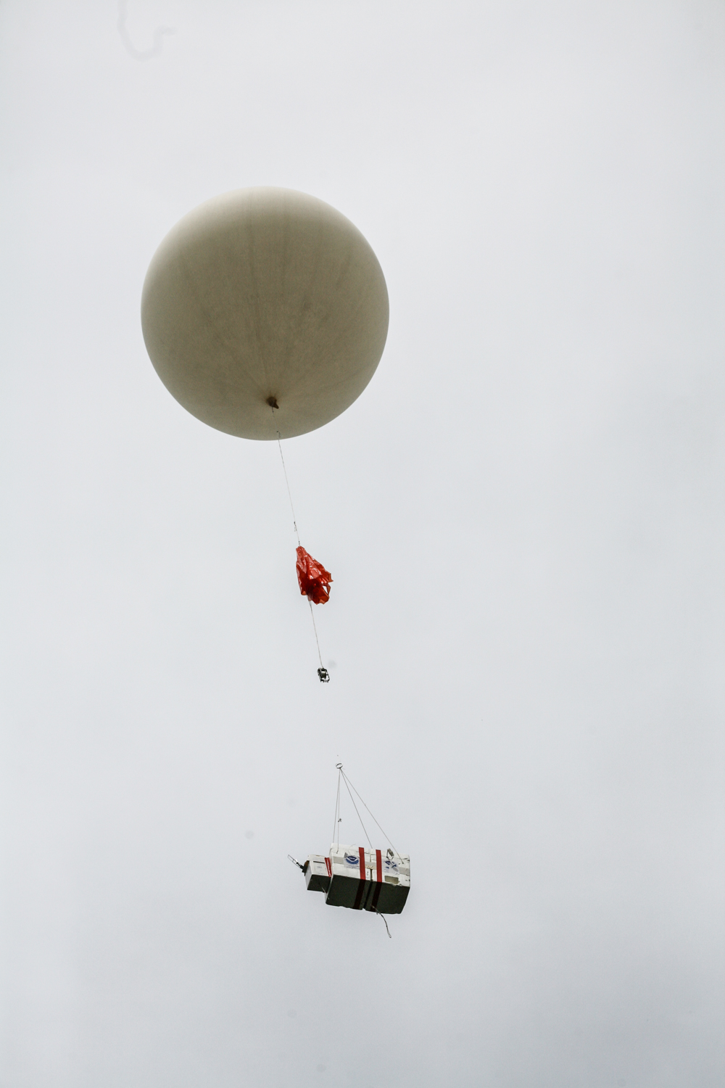
Dual Sonde #2

Slide 26
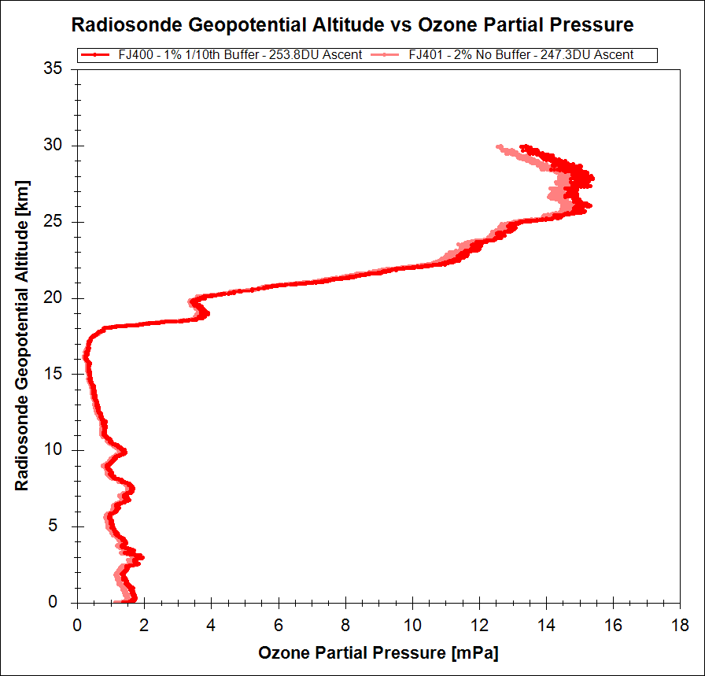
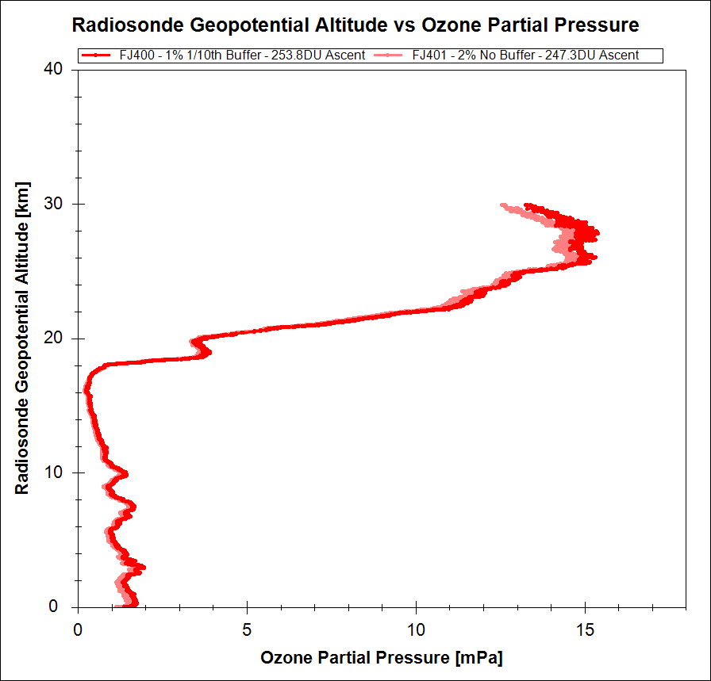
Fiji Dual Sonde 2 – 2/4/2015 @ 2:18pm
Sonde A – 1% 1/10th Buffer
CMR = 283.5DU
SBUV = 253.8DU
Sonde B – 2% No Buffer
CMR = 271.3DU = -12.2DU = -4.3%
SBUV = 247.3DU = -6.5DU = -2.6%

Slide 27
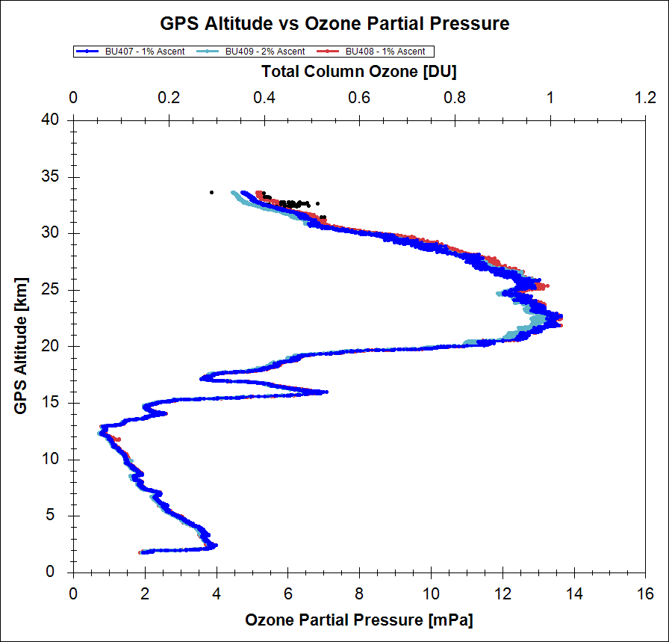
Boulder Quad Sonde 1
We do not see the separation of readings between solution types at the mid latitudes.

Slide 28
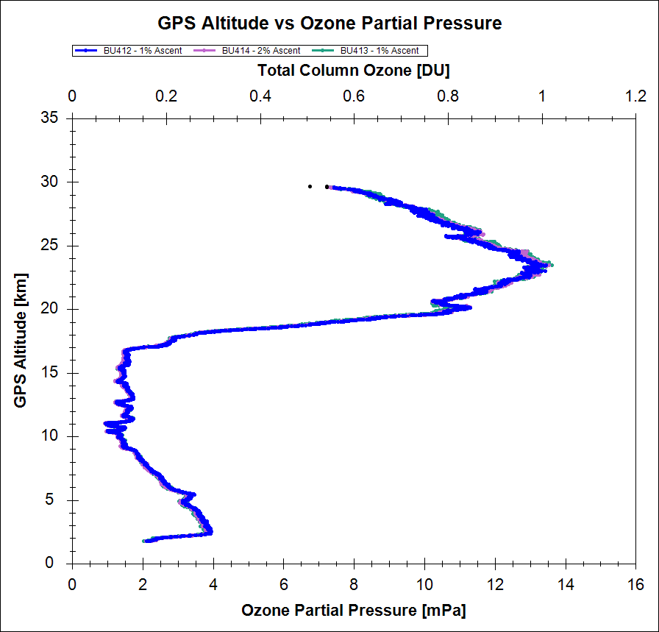
Boulder Quad Sonde 2
We do not see the separation of readings between solution types at the mid latitudes.

Slide 29
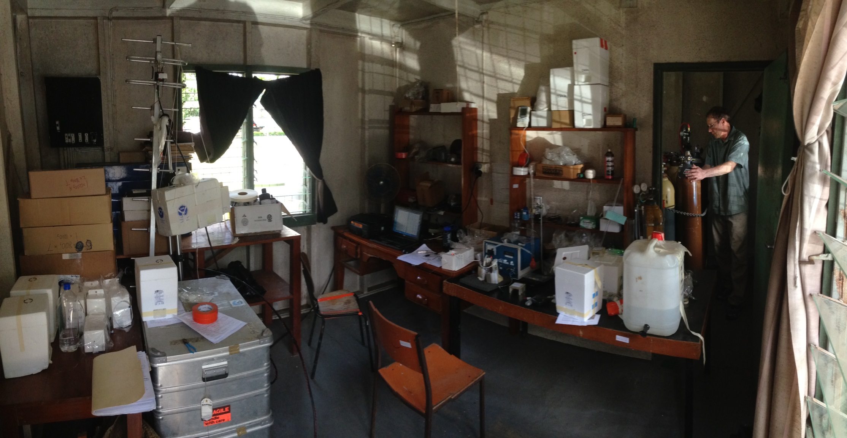

Slide 30
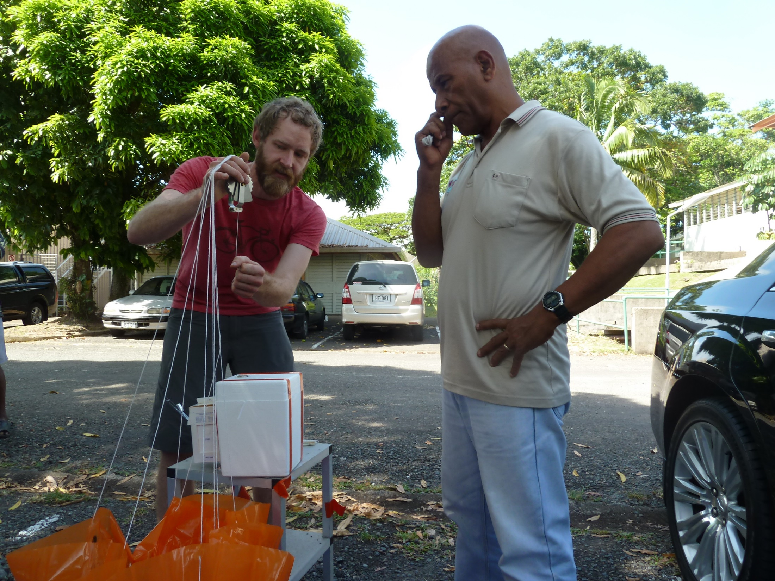
Patrick and Matakite

Slide 31
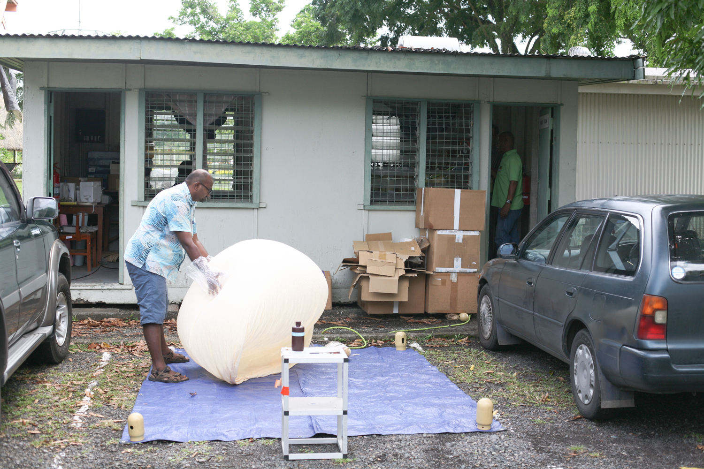

Slide 32
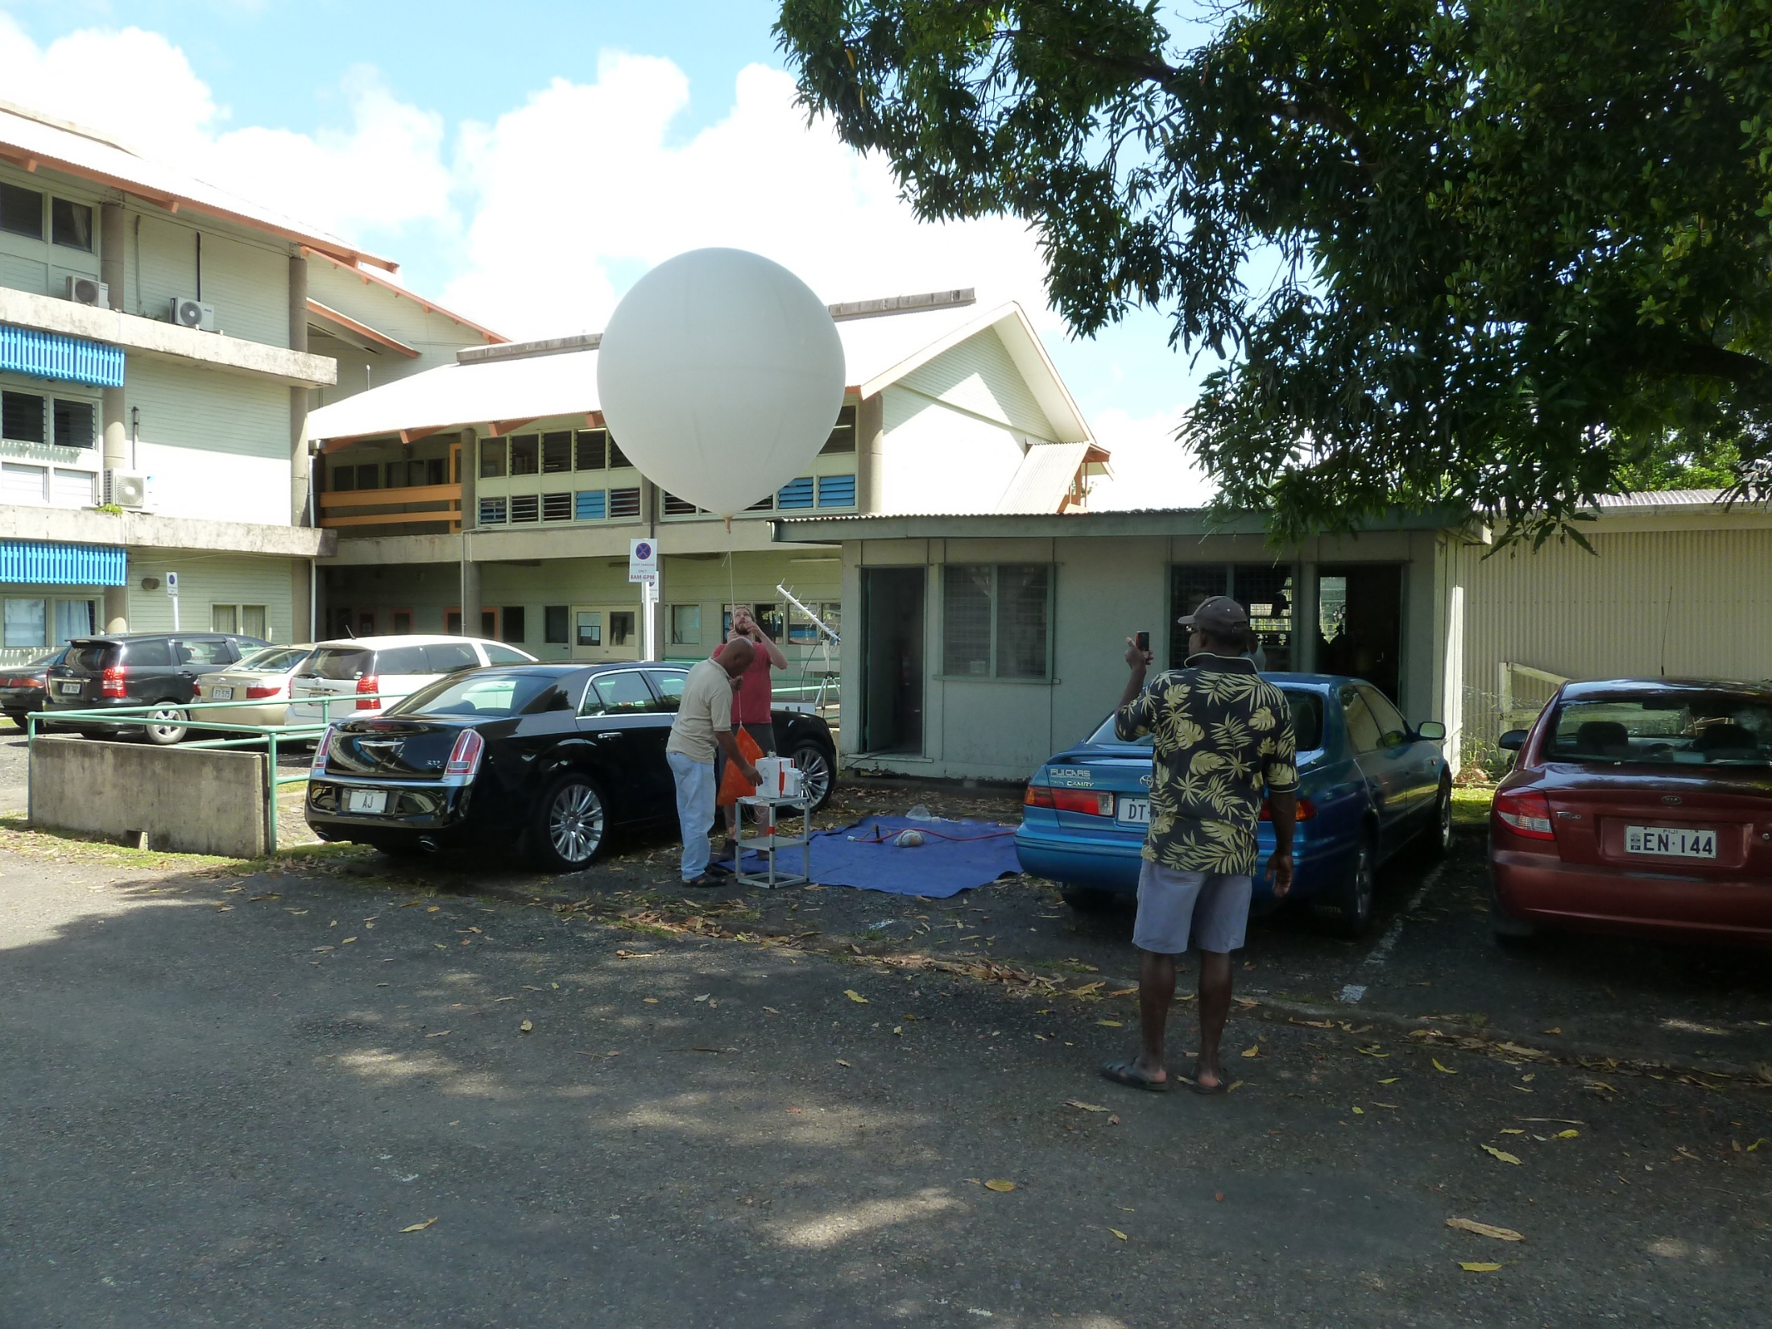
University of South Pacific balloon launch site.

Slide 33


Slide 35
The 2% KI unbuffered solution source came from the 1960s-1970s air pollution and ozone studies. The potassium iodide method was

Slide 37
Birdsall, C. M., A. C. Jenkins, and E. Spadinger,
Iodometric determination of ozone,
Analytical Chemistry, 24, 662-664, 1952.
Conclusion
In the concentration investigated (1 to 35 mole %) the use of a 2% unbuffered aqueous solution of potassium iodide for the analytical determination of ozone gives precise results which are accurate to 2% when compared with a physical method.

Slide 40
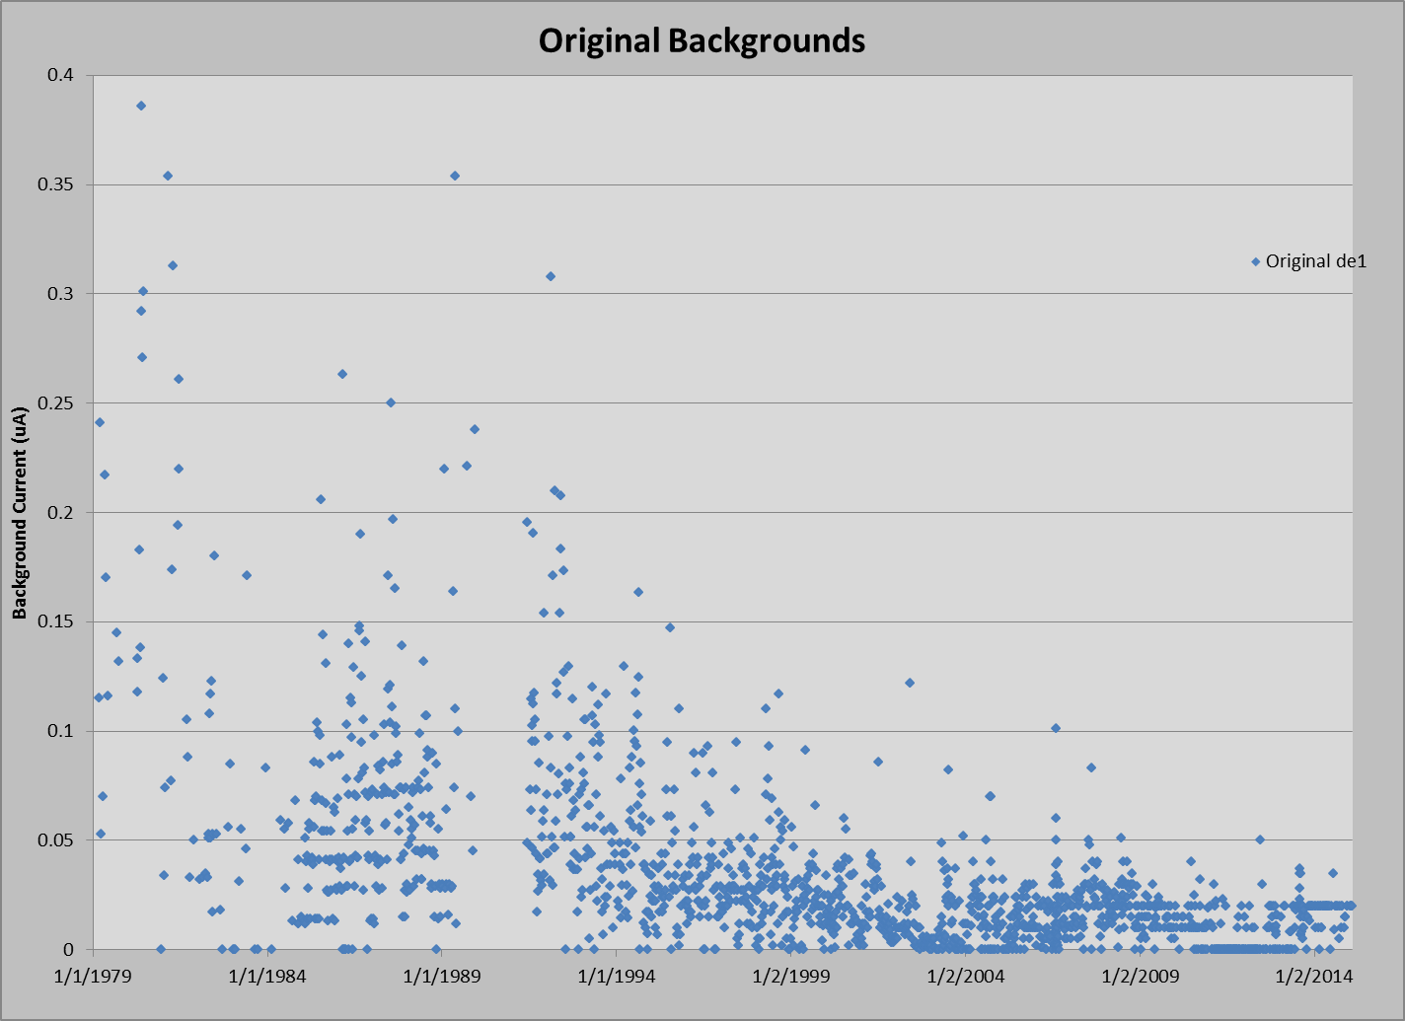
Step 2 – Background Reduction

Slide 41
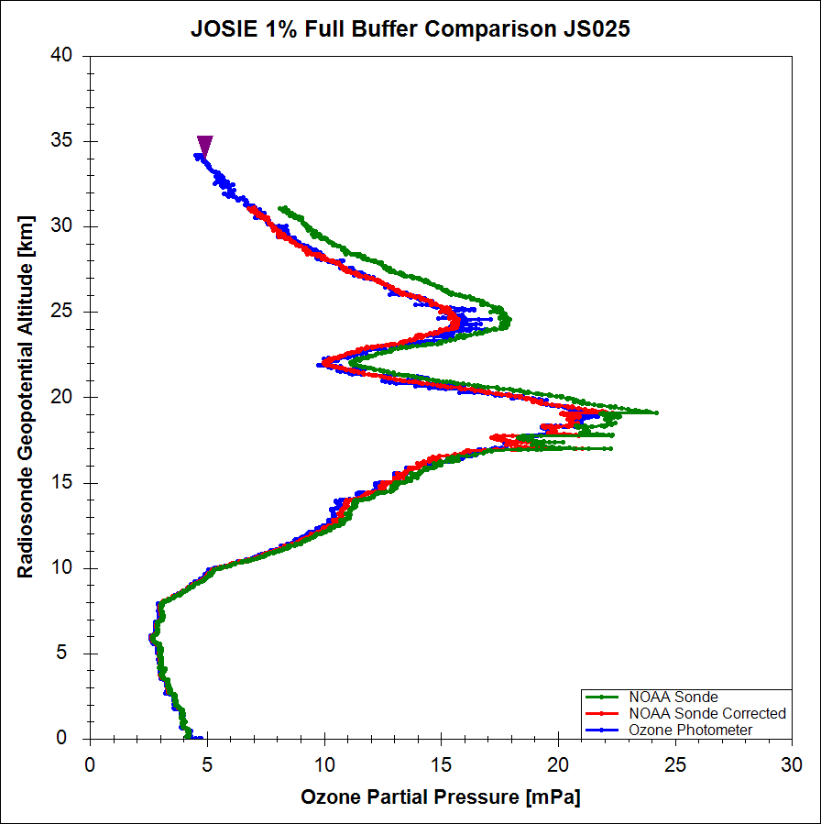

Slide 42
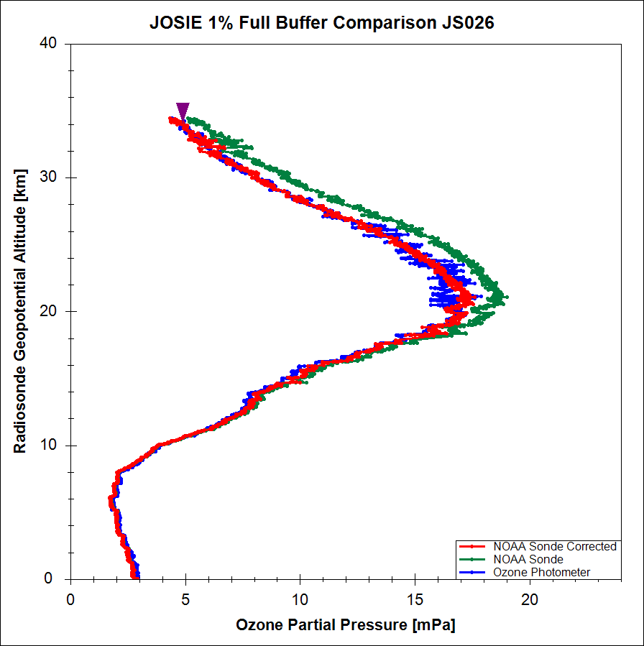

Slide 43
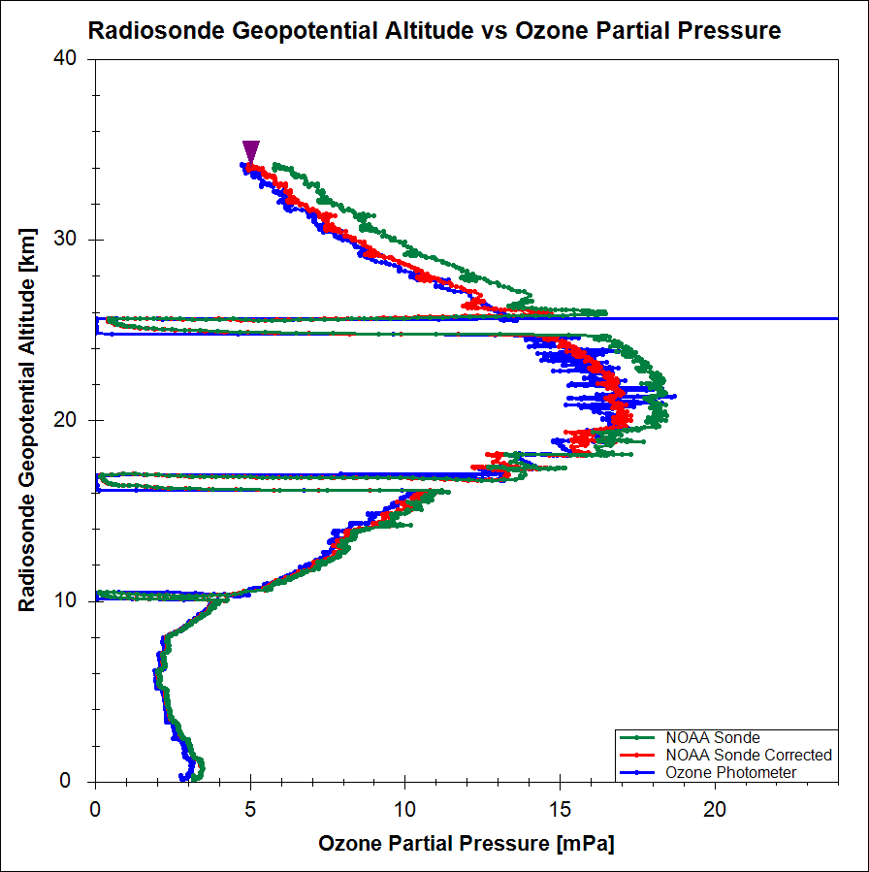
JOSIE 1% Full Buffer Comparison JS027

Slide 44
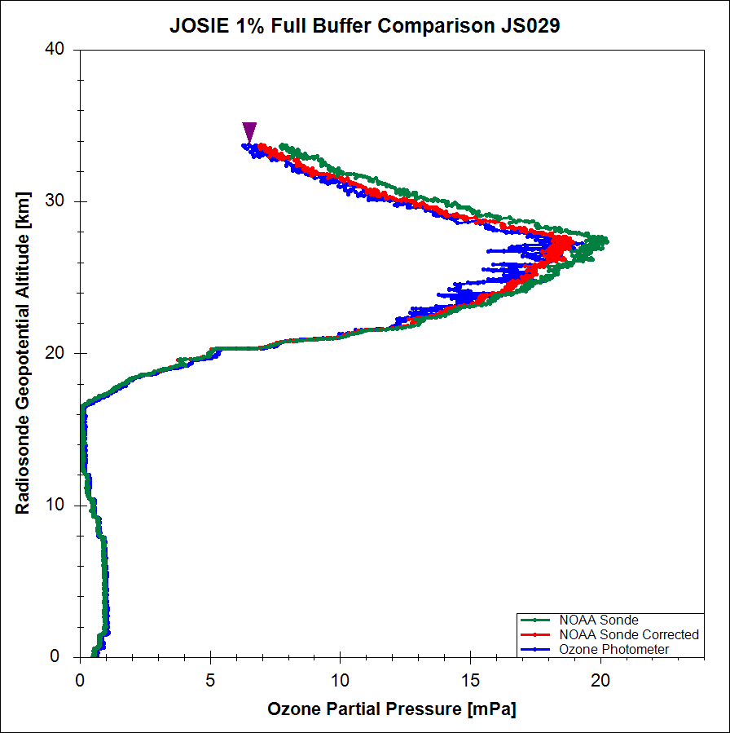

Slide 45
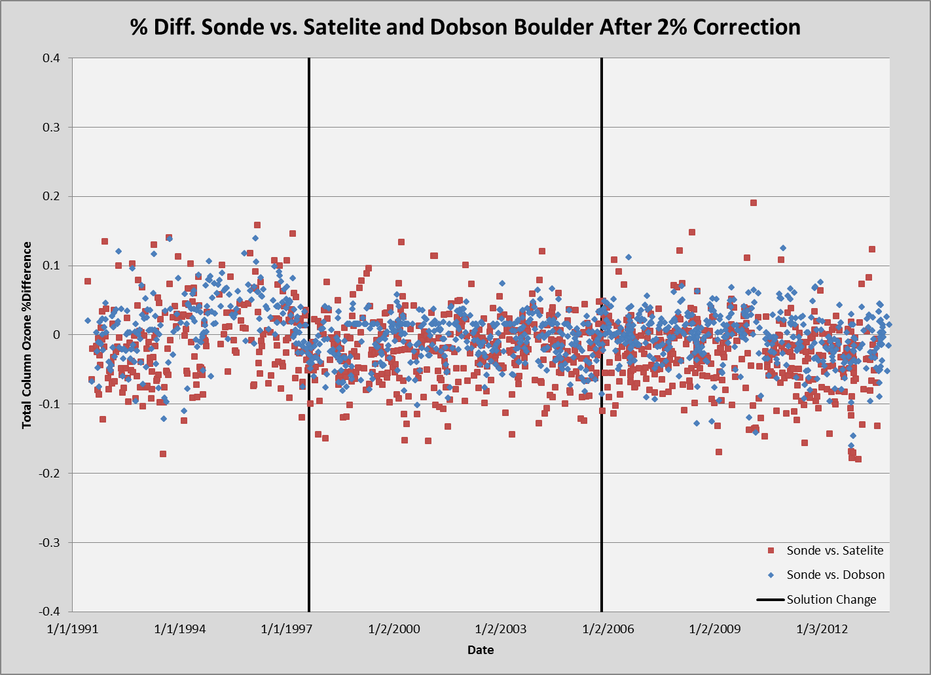
After 2% correction means the profiles were multiplied by linear 1.04 (best correction for now).

Slide 46
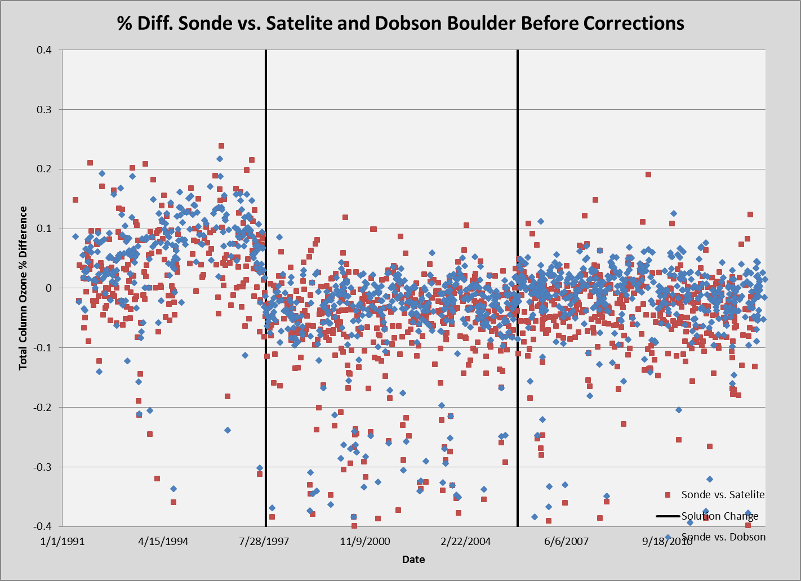

Slide 47
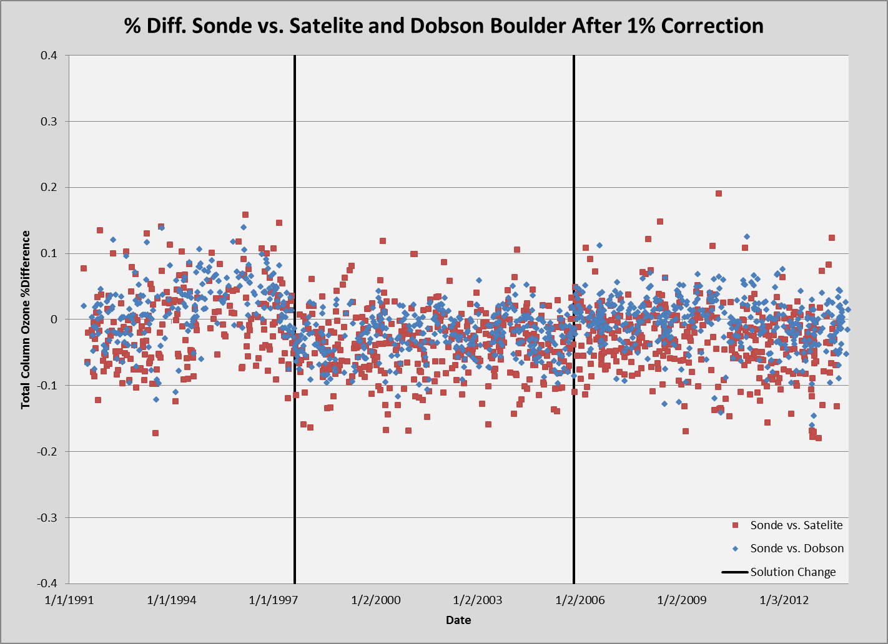
After 1% correction means the 1% full buffered profiles were multiplied by ozone amount dependent correction to reduce high reading of ozone from buffers.

Slide 48
Sonde vs. Satelite = -0.63%
Sonde vs. Dobson = 1.59%
Sonde vs. Satelite = -2.25%
Sonde vs. Dobson = -0.66%
Sonde vs. Satelite = -2.79%
Sonde vs. Dobson = -0.42%

Slide 49
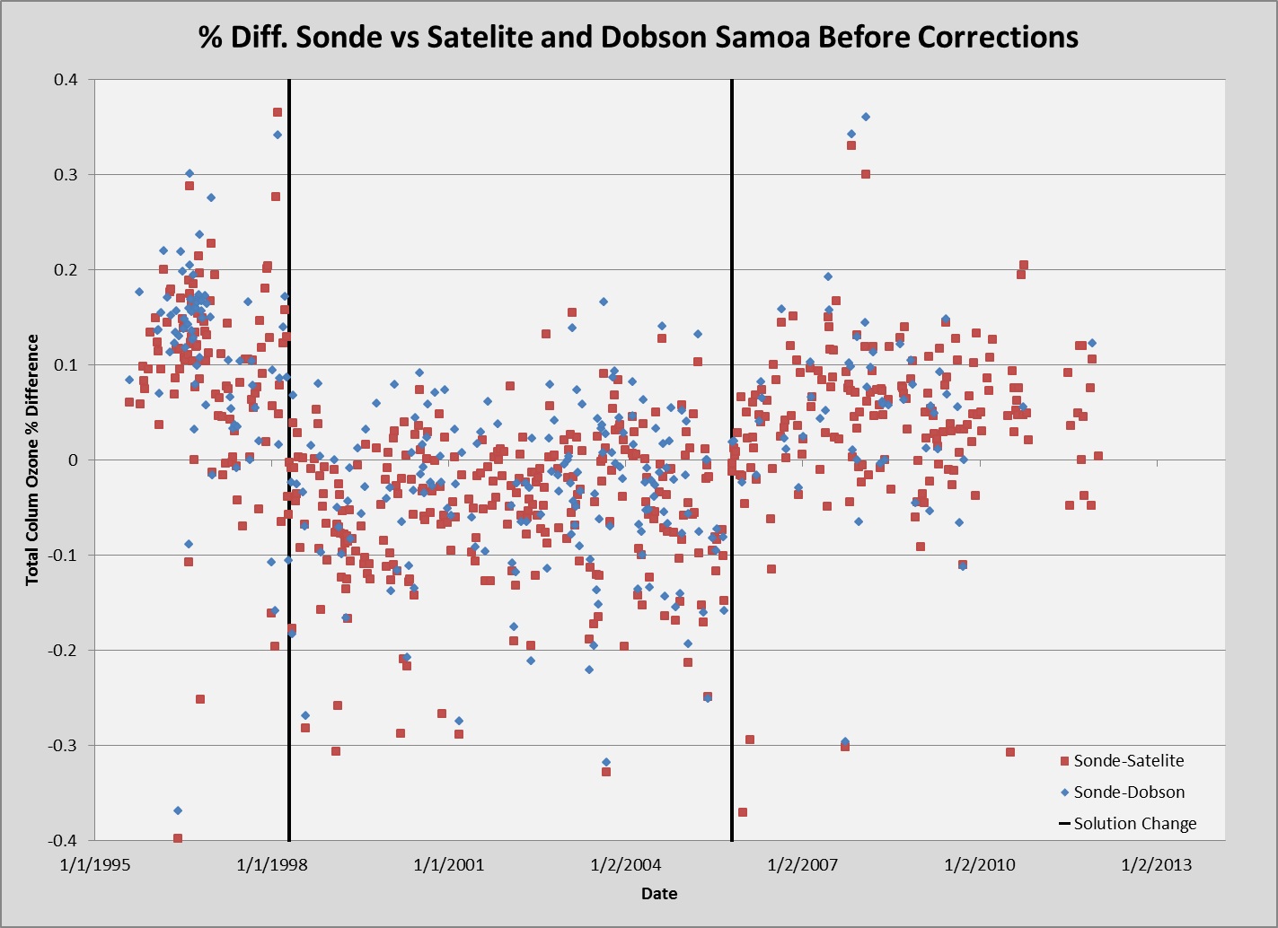

Slide 50
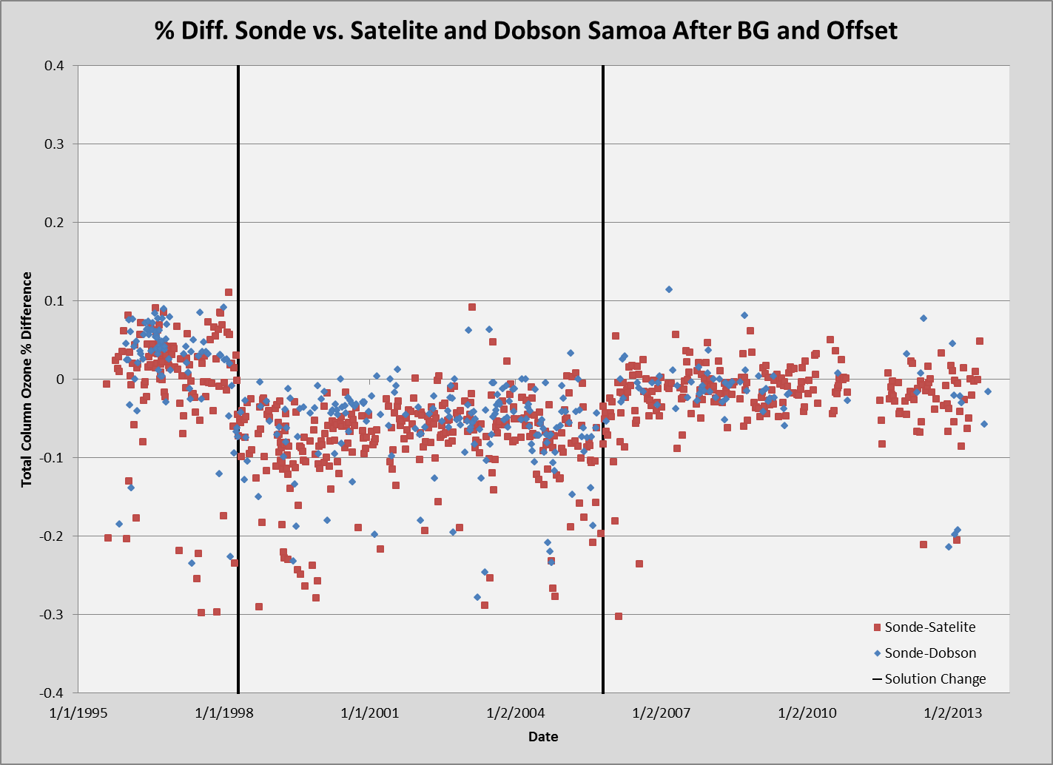

Slide 51
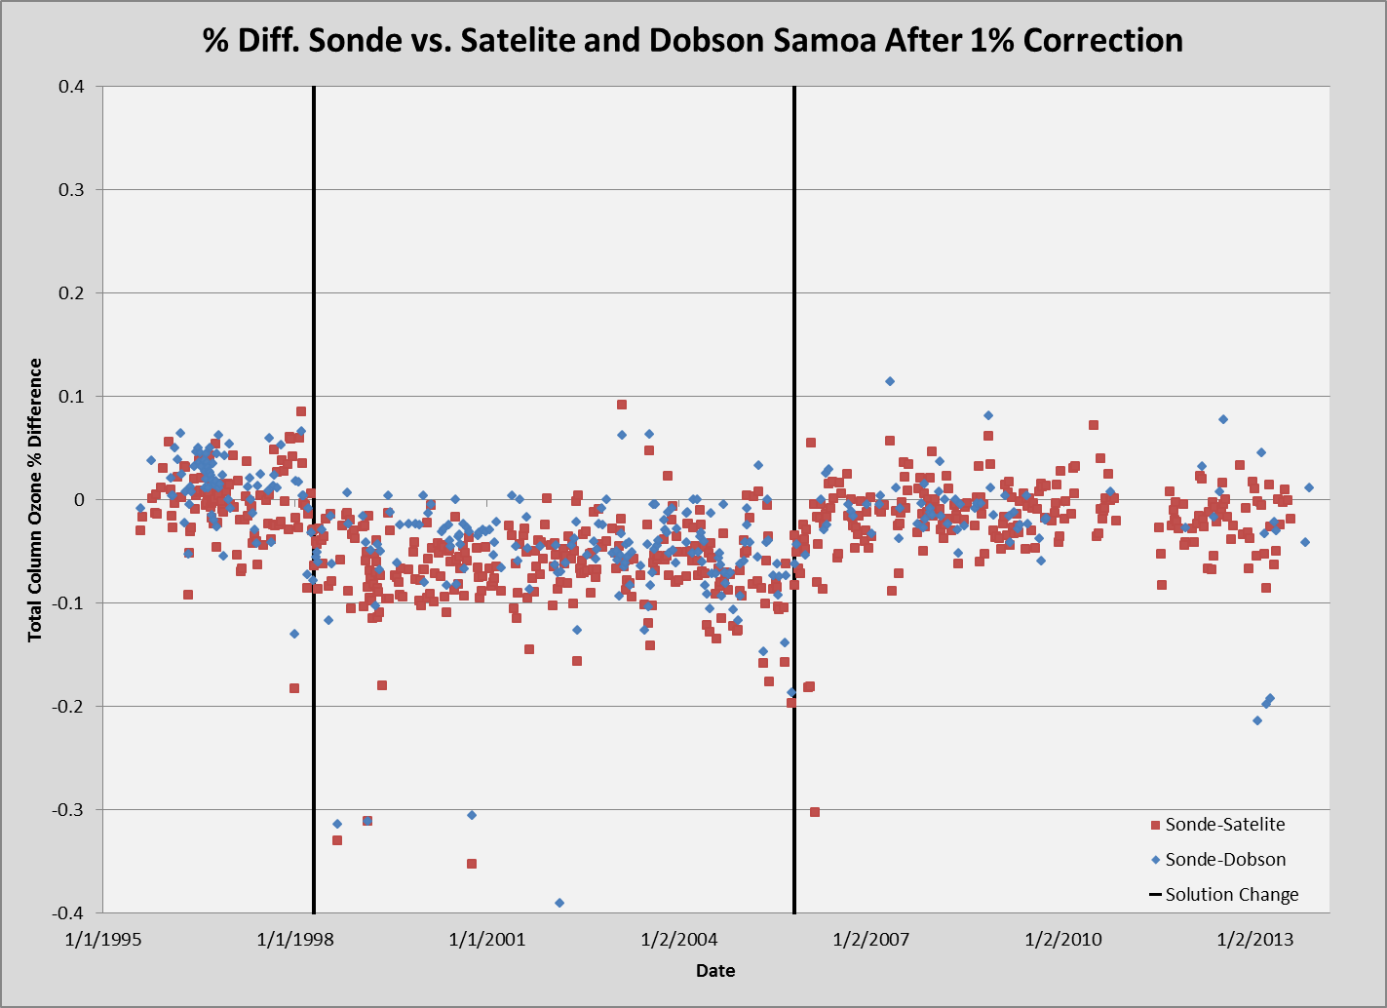

Slide 52
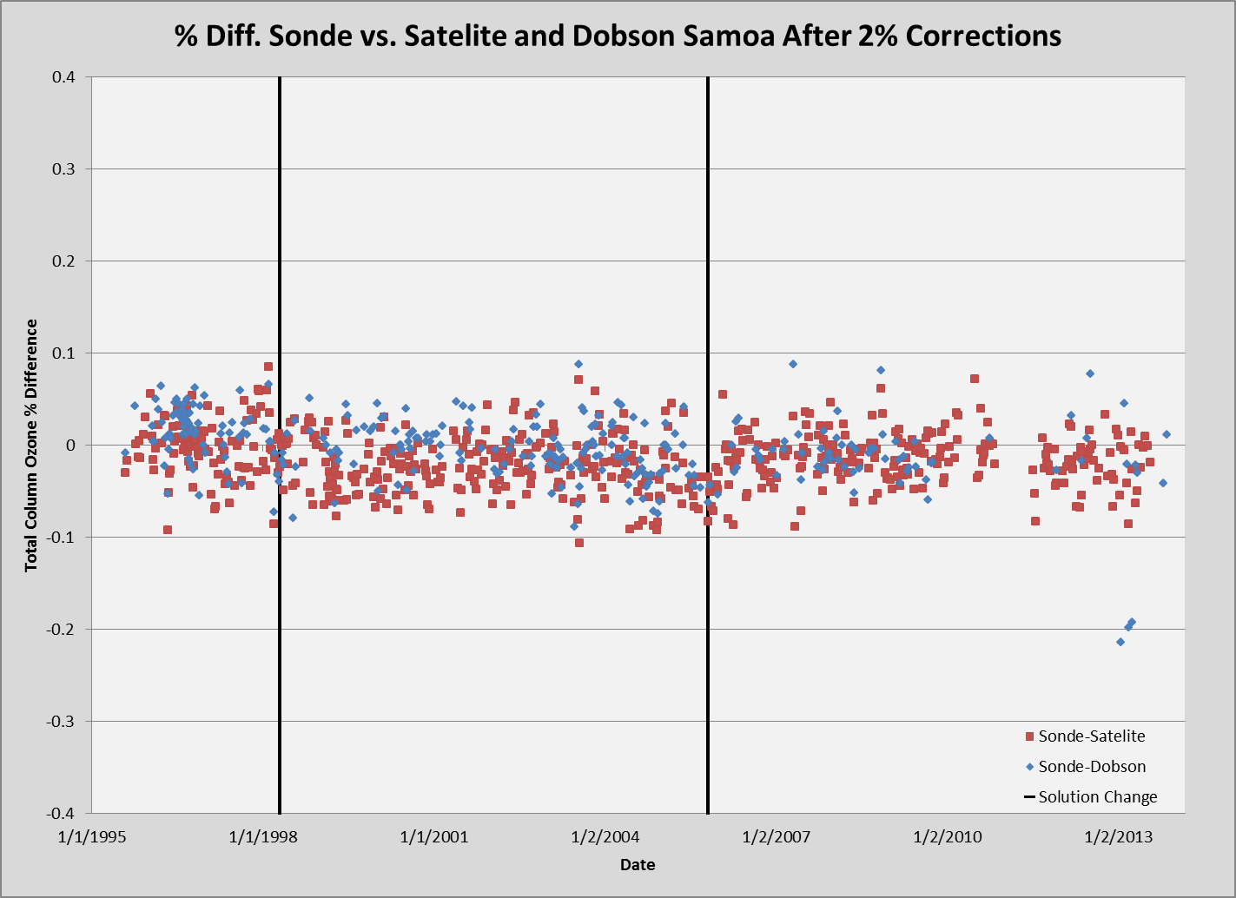

Slide 53
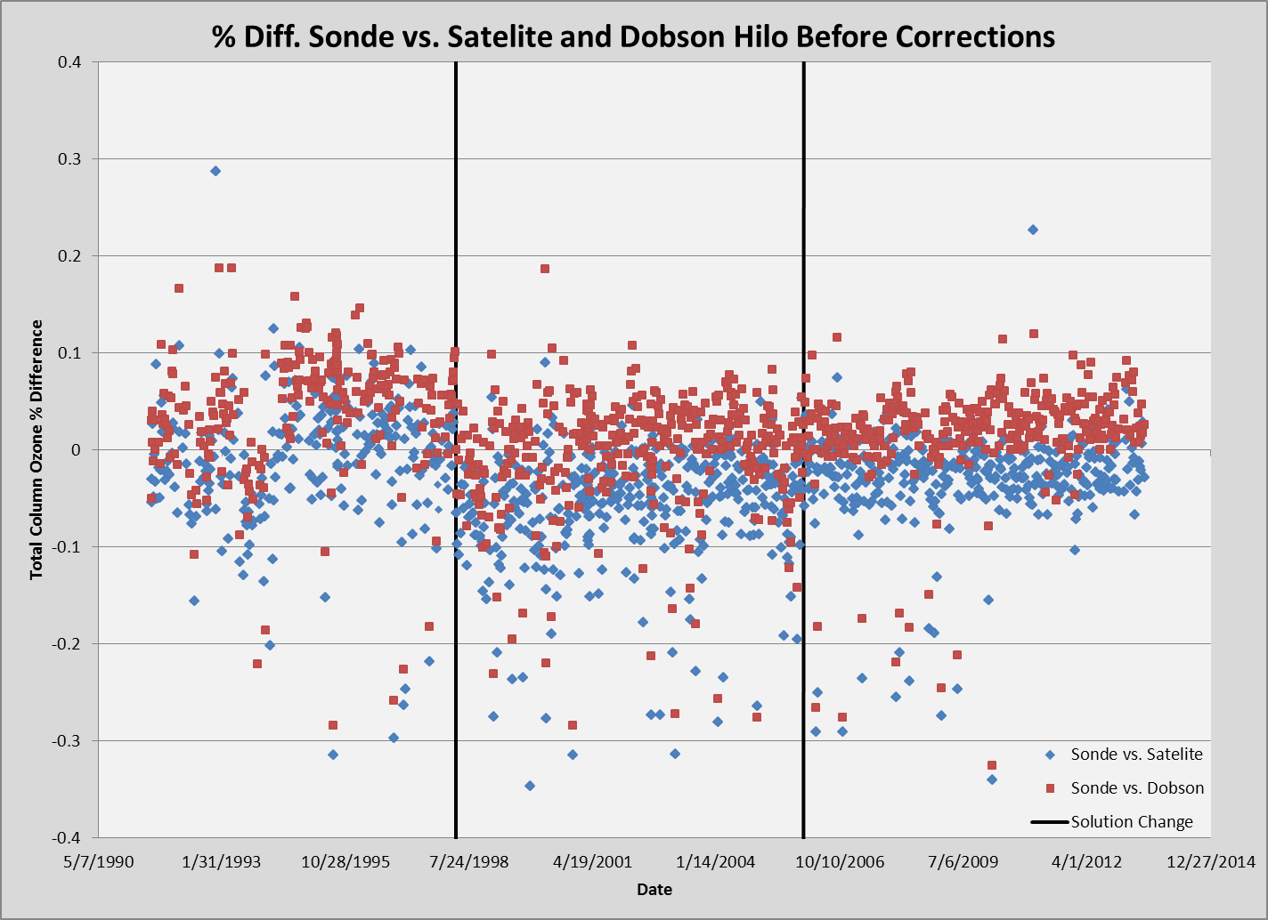

Slide 54
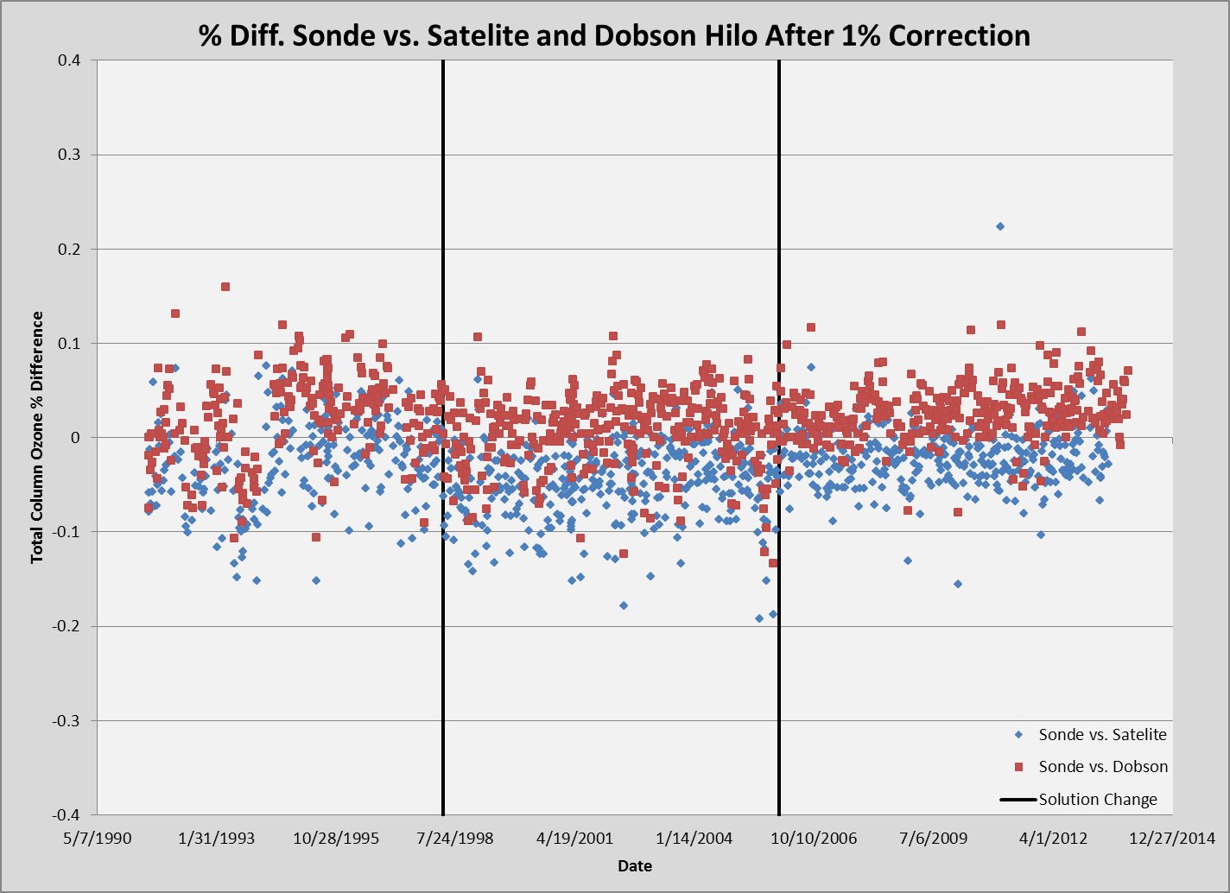

Slide 55
