Slide 1
Utilizing CarbonTracker-CO₂ for evaluation of satellite products
Andy Jacobson
University of Colorado Boulder and NOAA Global Monitoring Laboratory
CarbonTracker updates
Evaluation of CarbonTracker CO₂ model
Evaluation of OCO-2 retrievals

Slide 2
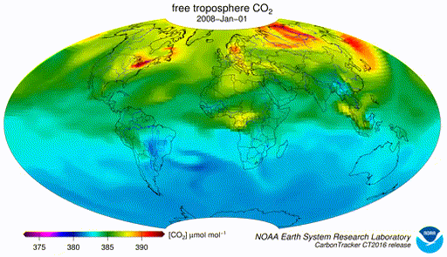
CarbonTracker updates
CT2019B
  Previous release
CT2022
  Current release, 2000-2020
CT-NRT.v2023-1
  2021-Sep 2022
CT-NRT.v2023-4
  2021-Feb 2023
  underway
TM5-MP and CT-Next underway

Slide 3
CT2022 withheld data
Latest ObsPack releases all designate 5% of the assimilable measurements as withheld for cross-validation.
Careful attention is paid to independence of withheld from assimilated data.
CT2022 largely unbiased and with good χ² statistics…even though these data are not assimilated!

Slide 4
NOAA light aircraft timeseries
Model residuals suggest insufficient wintertime CO₂ release from northern tier land
Much better performance than previous releases
More variability in NH summer

Slide 5
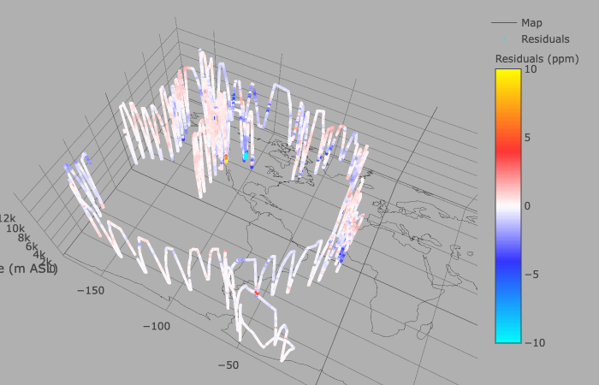
ATom-3 (Sep-Oct 2017)
CT2022 website has interactive 3-D visualization tool
CT2022 campaigns visualization
ATom, HIPPO, ACT-America, ORCAS, ABOVE, SeaCRS, ECO, …
Some areas of disagreement suggest missing flux signals, but transport looks largely unbiased.

Slide 6
CT2022 minus AirCore (34 levels)
NOAA’s AirCore samples multiple species throughout the entire column.
Previous CT releases showed notable excess of CO₂ in the stratosphere.
Increase of vertical resolution from 25 to 34 levels makes a big difference.

Slide 7
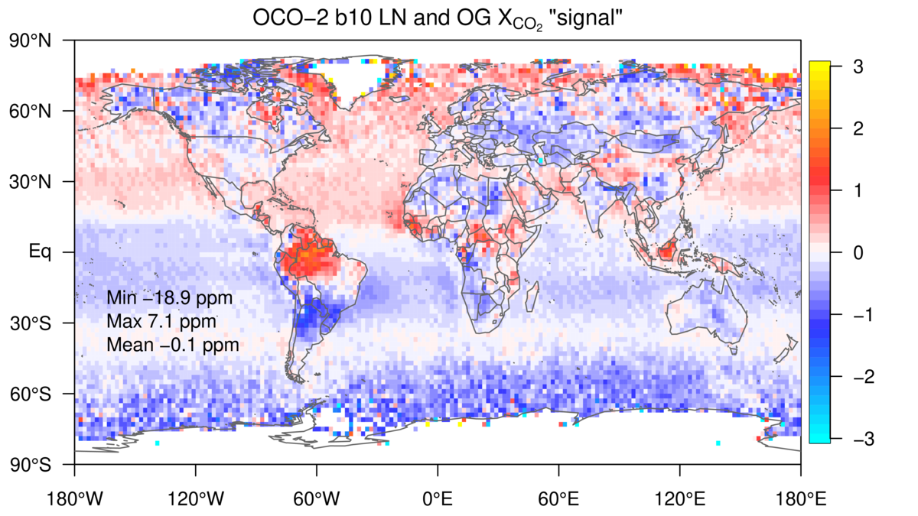
OCO-2 retrievals minus CO₂ reference

Slide 8
Conclusions
CarbonTracker is a useful tool for satellite retrieval evaluation
CT is a proxy for accurate in situ measurements of CO₂ and CH₄
Our models have simulated tracers everywhere that there’s a sounding…no complicated matching criteria
Existing CarbonTracker CO₂ products go through early 2023
CT2022 extended by CT-NRT.2023-4
CarbonTracker CH₄ newly available and being used for retrieval evaluation

Slide 9
CT2019B minus AirCore (25 levels)

Slide 10
TM5 levels
CT2022 has improved vertical resolution in the upper troposphere and stratosphere.
More levels above 600 hPa.

